Slide 1

Results are In:
Water Smart Allocation and Tiered Rates Program
2014 Water Smart Innovations
Matthew S. Dickens
Resource Conservation Manager
Valencia Water Company

Slide 2
Purpose of Presentation
About Valencia Water Company
About the Water Smart Allocation and Tiered Rates Program
Conservation Rate Design and Implementation for Multiple Customer Classes
WaterSMART in Action
Results: Customer Acceptance
Results: Water Use Trends
Lessons Learned and Next Steps

Slide 3



Valencia Water Company
Investor Owned Utility
Location – Northern Los Angeles County
Population – Approximately 117,000
Annual Sales – 9.7 Billion Gallons
Memberships Include – WaterSense Promotional Partner, Alliance for Water Efficiency, California Urban Water Conservation Council

Slide 4
About the Water Smart Allocation and Tiered Rates Program

Slide 5
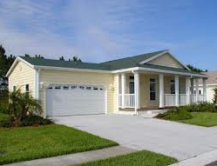
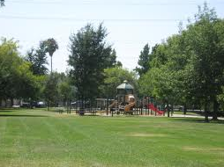
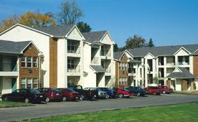
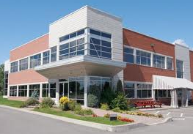
Conservation Rate Design Implementation Plan
Phase I – 2011 Residential
Phase II – 2012 Dedicated Irrigation Meters
Phase III – 2016 Multi-Family Residential and Public Authority
Phase IV – 20?? Commercial/Industrial/Institutional

Slide 6

Goals for Conservation Rate Design
Achieves Revenue Neutrality
Is Consistent with “Cost of Service” Principles
Stimulates Water Conservation
Increases Consumer Education
Avoids Rate Shock
Is Socially Acceptable

Slide 7
Defining “Water Allocations”
Often to referred to as “Water Budgets”, WaterSMART Allocations identify and establish water use baselines for customers using customized and site specific water use assessments.
~ Components Include ~
Indoor Allocation – Based on 55 gallons per person per day for 4 people for a given billing period (Variances available for additional persons).
1
Outdoor Allocation – Uses publicly available aerial imagery and GIS software to measure each residential customer’s landscaped area and includes varying monthly Evapotransporation needs required to keep plants happy and healthy (ET from Santa Clarita Valley CIMIS Station 204).
2
Tiered Rates – Once the allocation has been established, the WaterSMART Program uses tiered rates to reward and encourage water use efficiency by providing increasing economic price signals to discourage the inefficient, excessive, and wasteful use of water.
3
Conservation Choices – Customers who find themselves in the “Inefficient, Excessive, or Wasteful” ranges can reduce their water use, and water costs, by taking a few simple steps to bring water use down or through participating in one of Valencia Water Company’s Conservation Programs.
4

Slide 8
Conservation Rate Design and Implementation for Multiple Customer

Slide 9
Phase I – WaterSMART for Residential Customers

Slide 10
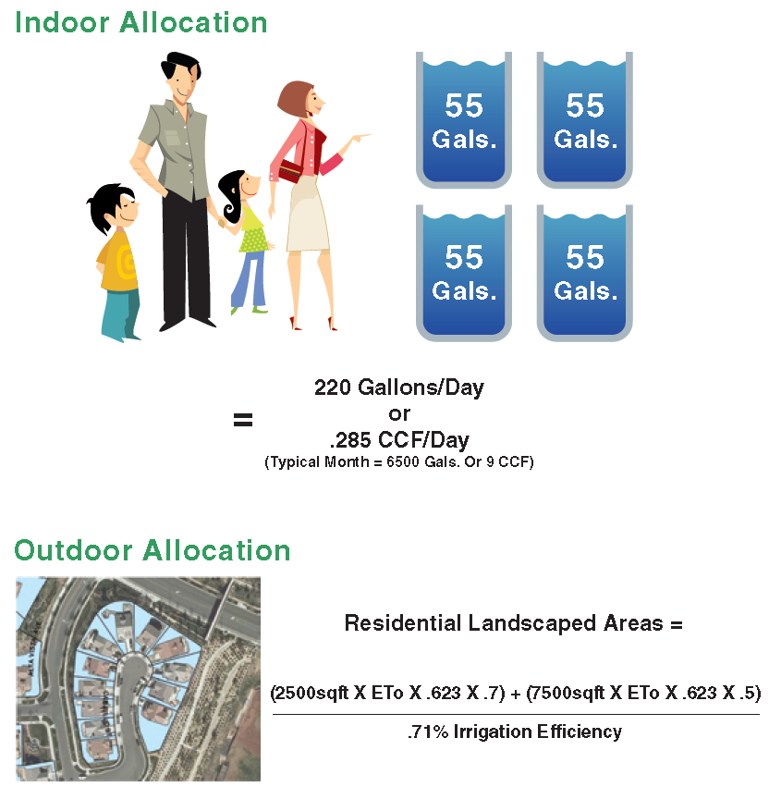
Residential WSA Program (2011)
Tier 1 - Indoor Allocation
Tier 2 – Outdoor
(Customer’s Allocation)
Tier 3 – 101-150%
Tier 4 – 151 – 200%
Tier 5 - >200%

Slide 11

Phase II – WaterSMART for Dedicated Irrigation Metered Customers

Slide 12
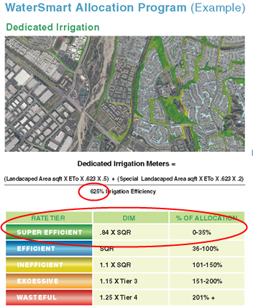
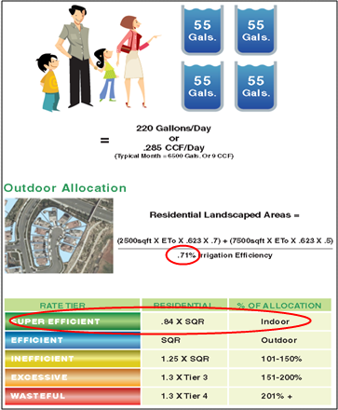
WaterSMART for Dedicated Irrigation (2012) Metered Customers
Vs.
Dedicated Irrigation Meter Program Residential Program

Slide 13
WaterSmart in Action

Slide 14
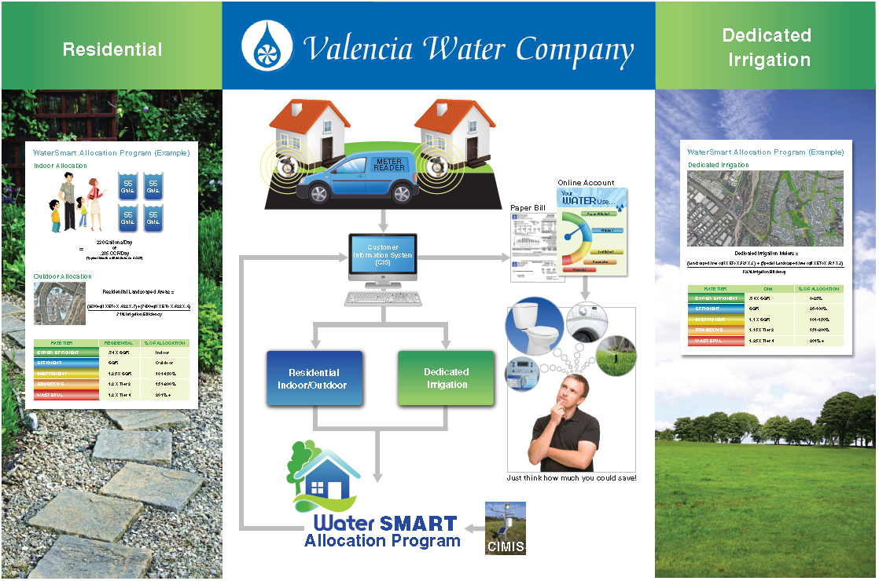
WaterSMART In Action

Slide 15
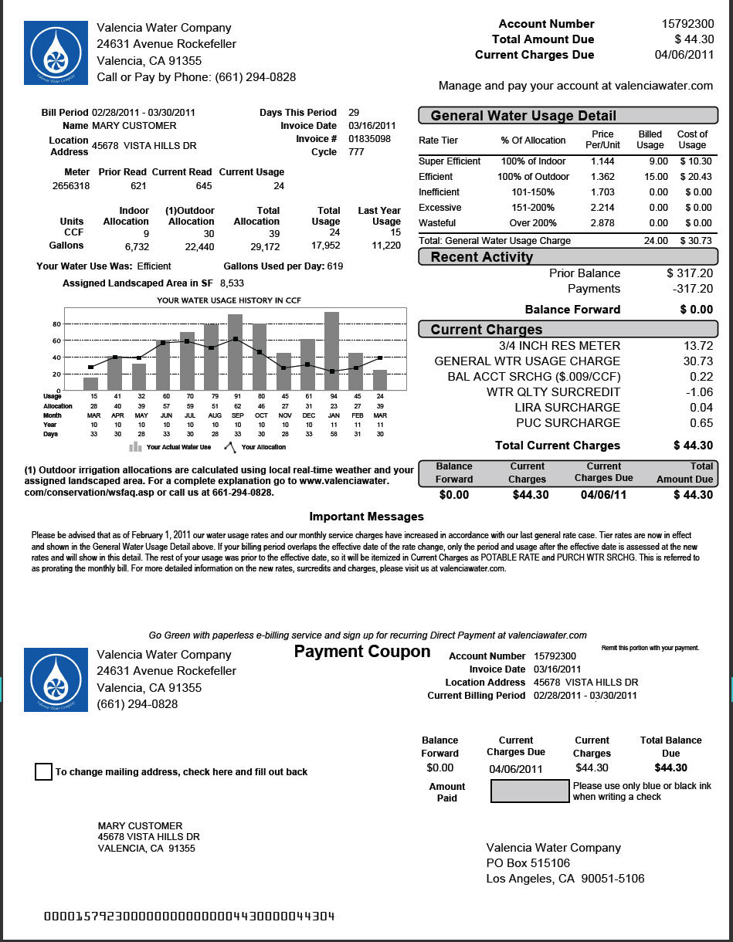
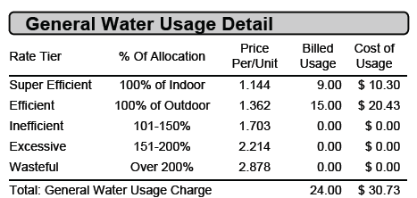
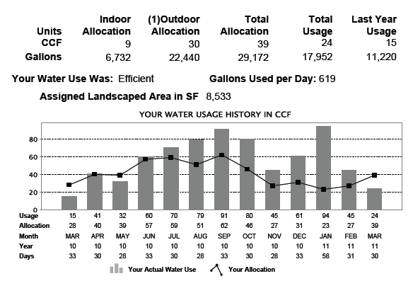
WaterSMART in Action

Slide 16
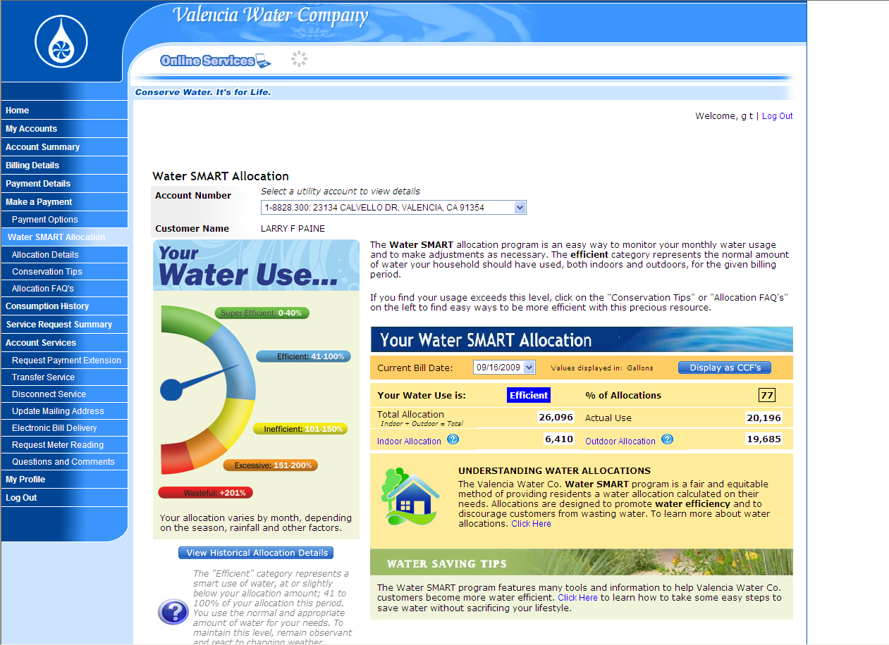
WaterSMART in Action

Slide 17
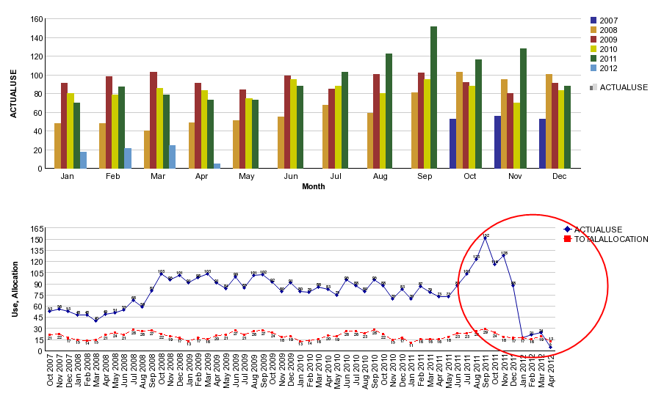
WaterSMART In Action
89,000 Gallons Saved Per Month!!!

Slide 18
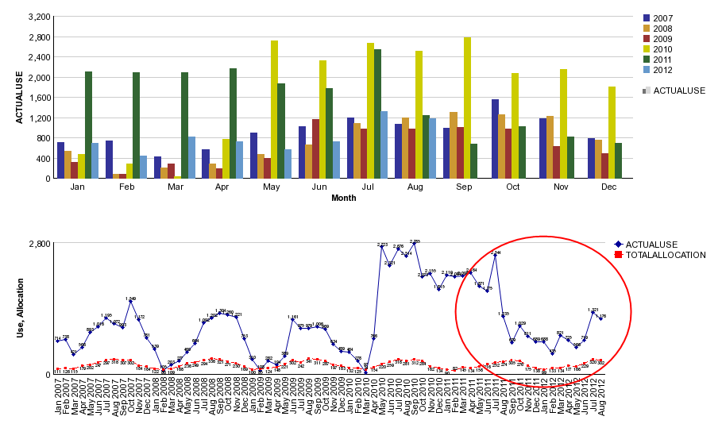
WaterSMART in Action
Over 35,000,000 Gallons Saved Since August 2011!!!

Slide 19
Results =
Customer Acceptance

Slide 20
Customer Acceptance
(Indoor Variance Requests)
 | 2011 | 2012 | 2013
Indoor Variance (1-2) | 41 | 58 | 47
Indoor Variance (>2) | 6 | 18 | 15
Indoor Variance (Medical) | 2 | 1 | 2
Indoor Variance (Other) | 5 | 0 | 0
Total | 54 | 77 | 64

Slide 21
Customer Acceptance
(Outdoor Variance Requests)
 | 2010 | 2011 | 2012 | 2013
Outdoor Variance Request | 15 | 38 | 26 | 9
Fire Control | 0 | 0 | 0 | 0
Erosion Control | 0 | 0 | 0 | 0
Admin. Variance | 0 | 70 | 41 | 1
Total | 15 | 108 | 67 | 10

Slide 22
Customer Acceptance
(Customer Inquiries)
 | 2010 | 2011 | 2012 | 2013
General Inquiry | 45 | 360 | 452 | 424
Tier Names Complaints | 0 | 2 | 4 | 1
Tier Rates Complaints | 0 | 1 | 0 | 0
Formal Complaints | 0 | 0 | 1 | 0
Total | 45 | 363 | 457 | 425

Slide 23
Customer Acceptance
(Focused Outreach)
 | 2010 | 2011 | 2012 | 2013
High Consumption Letter | 0 | 416 | 6382 | 5278
Total Residential Accounts | 25,518 | 25,672 | 25,859 | 26,198
Percent Receiving HCLS | NA | .14% | 2.0% | 1.7%
Residential Survey Requests | 238 | 263 | 850 | 490

Slide 24
Results =
Water Use Trends

Slide 25
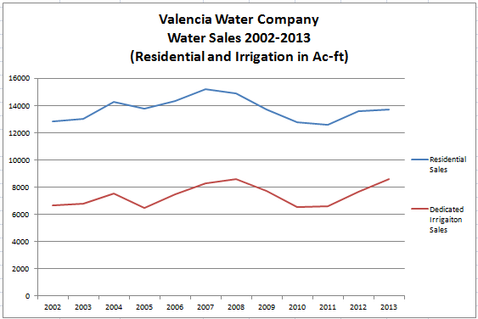
Water Use Trends

Slide 26
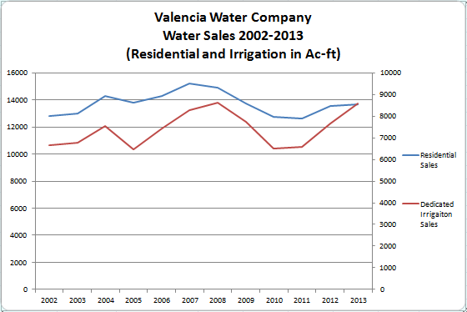
Water Use Trends
Estimated Water Savings (Residential) = 73.96 ac-ft (2011), 1184.2 ac-ft (2012), 2880.77 ac-ft (2013)
Total Estimated Water Savings= 4138.93 Ac-ft
1.348 Billion Gallons = 10.3%

Slide 27
Lessons Learned and Next Steps

Slide 28
Lessons Learned and Next Steps
Lessons Learned
Indoor Allocation Estimates Too High (Homes with less than 4 people)
Terminology Discrepancies/Mixed Messages (Is efficient really efficient?)
Drought Preparedness (Using actual weather to calculate irrigation when water needs are more likely to increase, when 20% reductions are requested)
Next Steps
Expand Coverage (Additional customer classes)
Increase Contact (Dedicated irrigation customers)
Continued Education (Consumers want more info)

Slide 29
Questions?
Matthew S. Dickens
Resource Conservation Manager
Valencia Water Company
661-295-6543
mdickens@valenciawater.com
Thank You!!!

