Slide 1


Effectively Implementing Water Budgets for Multiple Customer Classes
2012 Water Smart Innovations
Matthew S. Dickens
Resource Conservation Manager
Valencia Water Company
Ming-Chin Jeng
Vice President
DCSE

Slide 2
Purpose of Presentation
Responses to Changing Water Policy Conditions in California
Conservation Rate Design and Implementation for Multiple Customer Classes
WaterSMART Allocation Program Software Integration
WaterSMART at Work
Future Tools

Slide 3



Valencia Water Company
Investor Owned Utility - (Regulated by the CPUC)
Location – Northern Los Angeles County
Population – Approximately 115,000
Annual Sales – 9.2 Billion Gallons
Memberships Include – WaterSense Promotional Partner, Alliance for Water Efficiency, California Urban Water Conservation Council

Slide 4

Changes to Statewide Water Policy in California
20% Reduction in GPCD by 2020(State Legislature)
1-2% Annual Reductions per Customer Connection(CPUC)
18% Reduction in GPCD by 2018 (CUWCC)

Slide 5
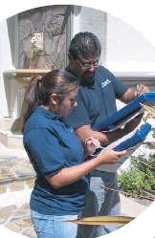
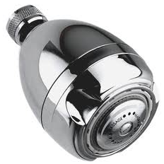
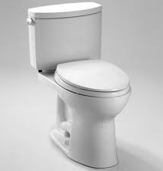
Valencia’s Conservation Strategy
Traditional (Widget Based) Program Approaches
Regulatory
Operations/Supply Management
Incentives and Rebates
Education and Training

Slide 6
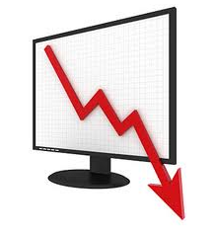
Conservation Program Challenges
Decreased Program Participation Rates
Market Saturation (Early Adaptors)
Decreased Water Savings Potential from Indoor Devices
Unpredictable Weather Conditions
Volatile Economic Conditions
Impacts on Revenue
Public Perception of Conservation
Questions: Are there other WCO‘s on the table that can rebrand/retool/reboot our conservation efforts?

Slide 7

Opportunity -Retail Water Rates
CUWCC BMP 1.4 (Utility Operations)
  70% Revenue from Volumetric Water Sales (Single Quantity Rate)
  30% Revenue from Fixed/Meter Charges
  V/(V + M) ≥ 70%

Slide 8
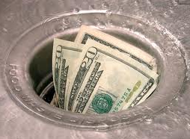
Retooling Retail Water Rates
Rebates and Incentives
$Price$ Programs
Operations
Education and Training
Paradigm Shift in Valencia’s Water Conservation Rate Design

Slide 9
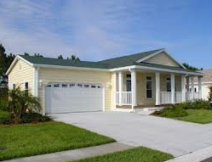
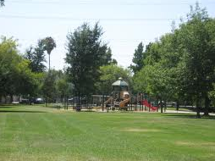
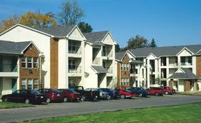
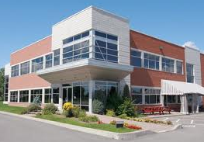
Conservation Rate Design Implementation Plan
Phase I – 2011 Residential
Phase II – 2012 Dedicated Irrigation Meters
Phase III – 2015 Multi-Family Residential and Public Authority
Phase IV – 20?? Commercial/Industrial/Institutional

Slide 10

Phase I: Residential WaterSMART Allocation Program

Slide 11
Goals for Conservation Rate Design
Achieves Revenue Neutrality
Is Consistent with “Cost of Service” Principles
Stimulates Water Conservation
Increases Consumer Education
Avoids Rate Shock
Is Socially Acceptable

Slide 12
Defining “Water Allocations”
Often to referred to as “Water Budgets”, WaterSMART Allocations identify and establish water use baselines for customers using customized and site specific water use assessments.
~ Components Include ~
Indoor Allocation – Based on 55 gallons per person per day for 4 people for a given billing period (Variances available for additional persons).
1
Outdoor Allocation – Uses publicly available aerial imagery and GIS software to measure each residential customer’s landscaped area and includes varying monthly Evapotransporation needs required to keep plants happy and healthy (ET from Santa Clarita Valley CIMIS Station 204).
2
Tiered Rates – Once the allocation has been established, the WaterSMART Program uses tiered rates to reward and encourage water use efficiency by providing increasing economic price signals to discourage the inefficient, excessive, and wasteful use of water.
3
Conservation Choices – Customers who find themselves in the “Inefficient, Excessive, or Wasteful” ranges can reduce their water use, and water costs, by taking a few simple steps to bring water use down or through participating in one of Valencia Water Company’s Conservation Programs.
4

Slide 13
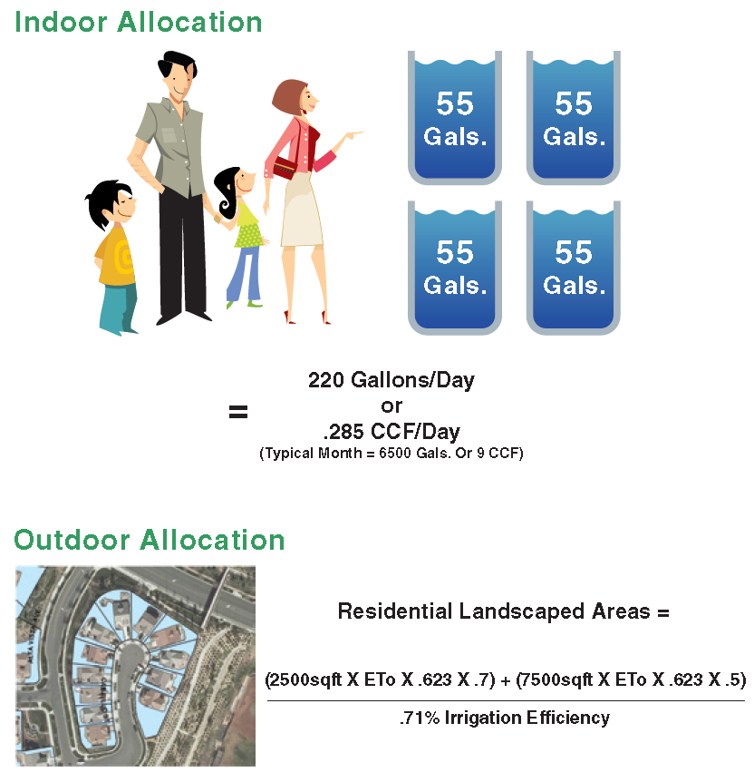
Residential WSA Program
Tier 1 - Indoor Allocation
Tier 2 – Outdoor
(Customer’s Allocation)
Tier 3 – 101-150%
Tier 4 – 151 – 200%
Tier 5 - >200%

Slide 14
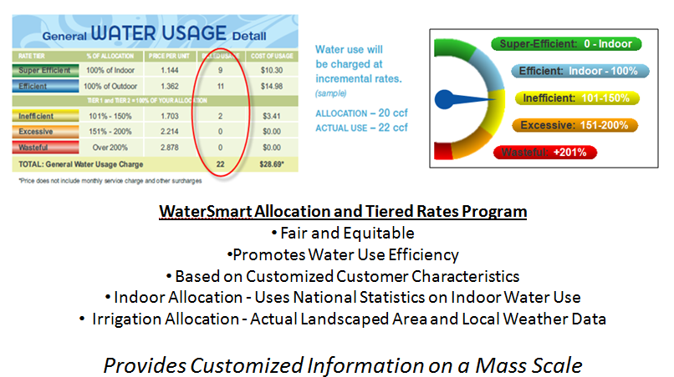
Tiered Rate Structure

Slide 15

Phase II – WaterSMART for Dedicated Irrigation Metered Customers

Slide 16
Conservation Rate Design Challenges
  Varying Demand/Consumption Loads and Use Profiles
  Significant Increases in Monthly Consumption (Golf Courses, Parks, etc…)
  Operational Capacities (62.5% IE v. 71% IE)
    Upgrade Costs (Back-end Sticker Shock)
  Growth for Recycled Water Use Customers

Slide 17
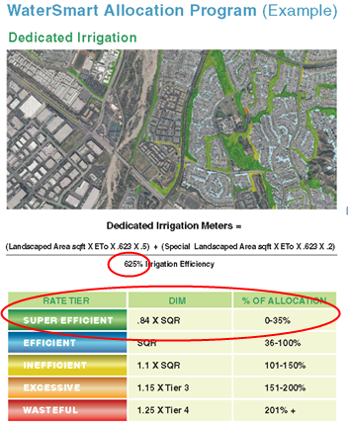
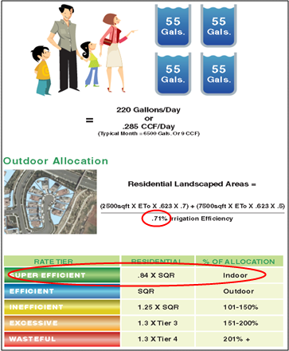
WaterSMART for Dedicated Irrigation Metered Customers
Vs.
Dedicated Irrigation Meter Program Residential Program

Slide 18
WaterSMART Allocation Program Software Integration

Slide 19
Phase I: Residential WaterSMART Allocation Software Integration

Slide 20
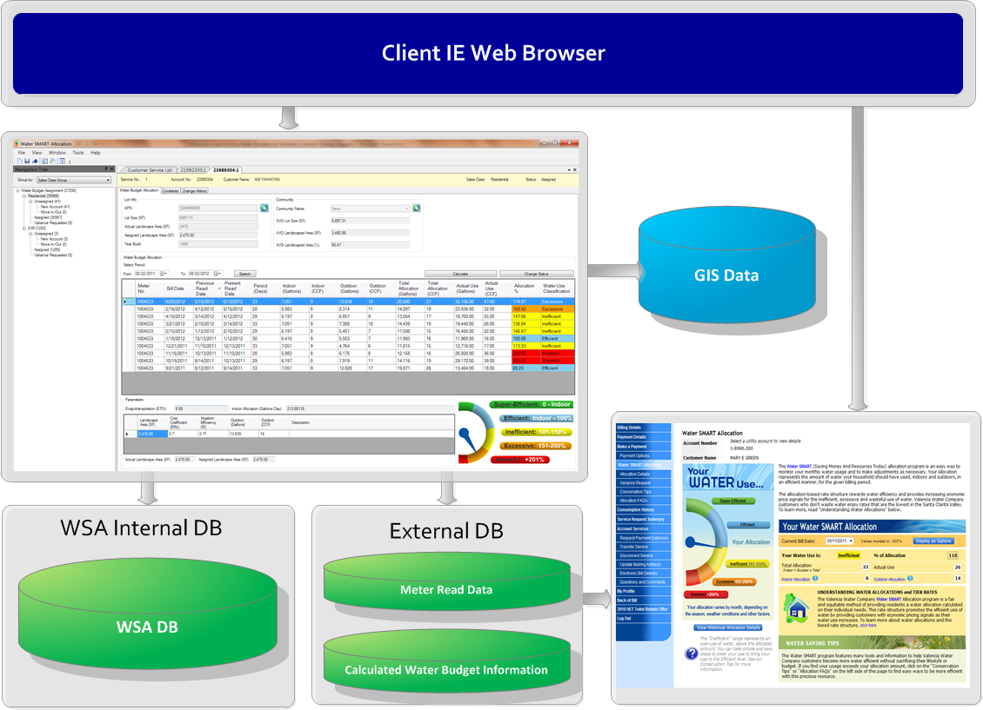
Software Design

Slide 21
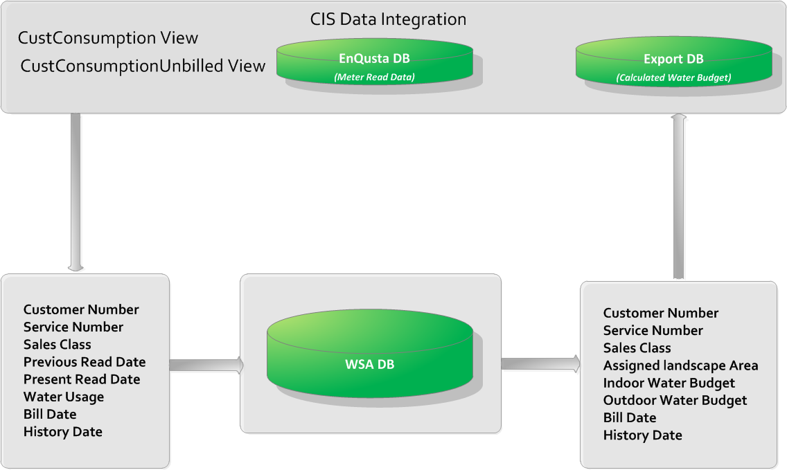
Customer Information System Integration

Slide 22
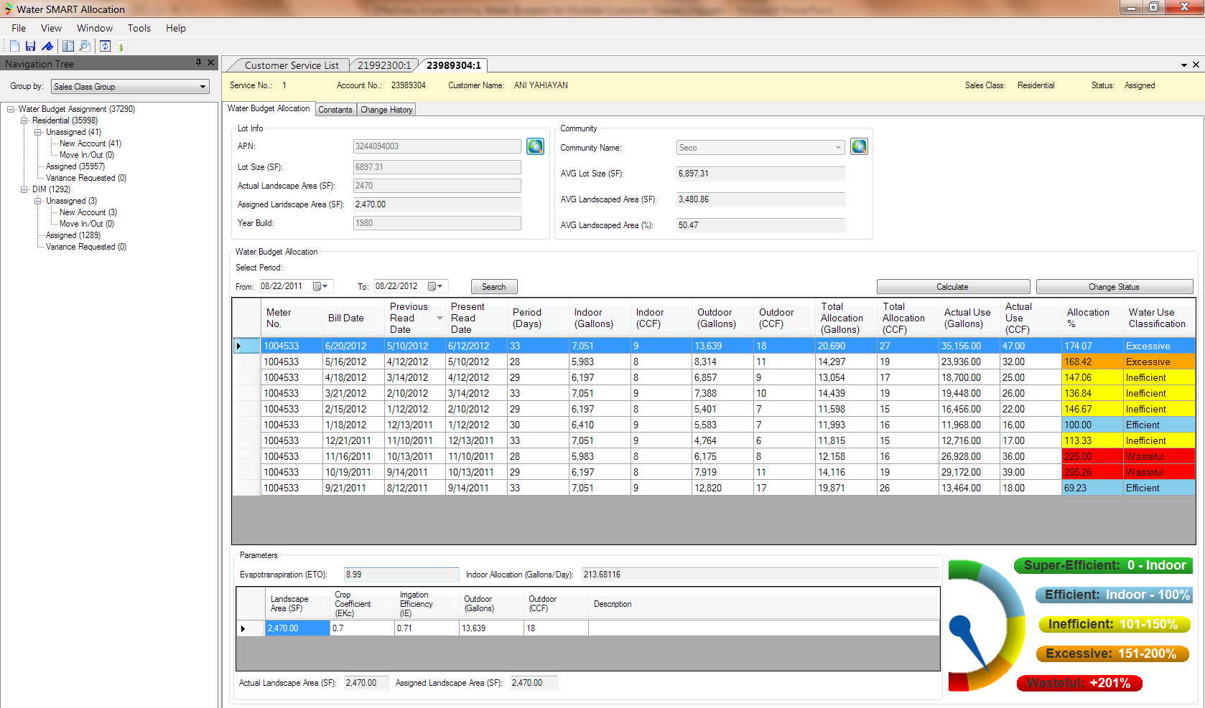
WaterSMART GUI-I

Slide 23
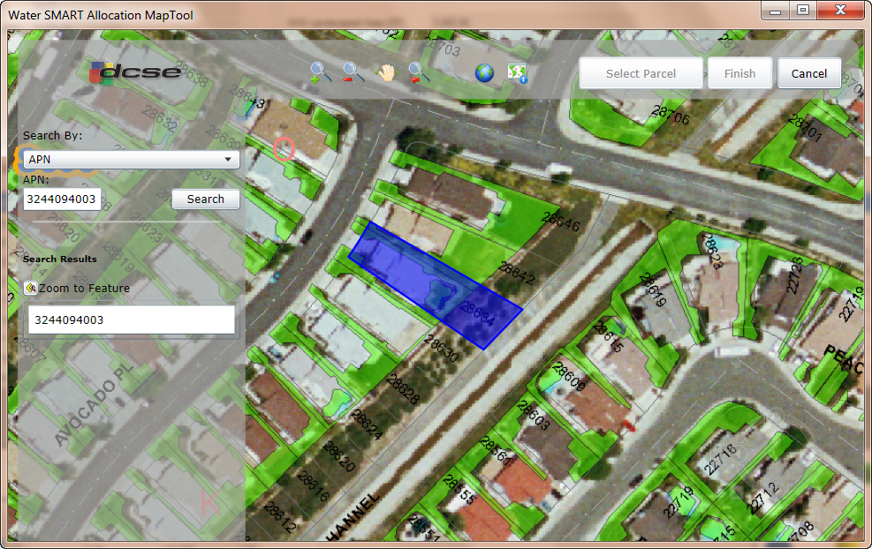
WaterSMART GUI-II

Slide 24
Phase II: Dedicated Irrigation Meter Software Integration

Slide 25
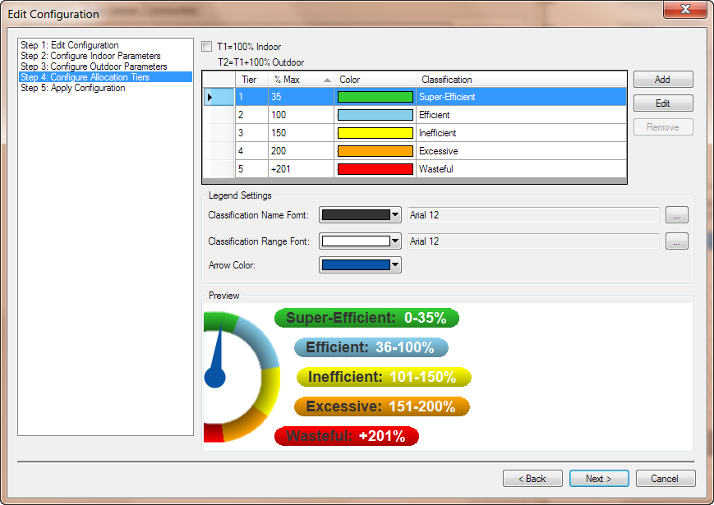
Software Upgrades
Configuration Wizard Added

Slide 26
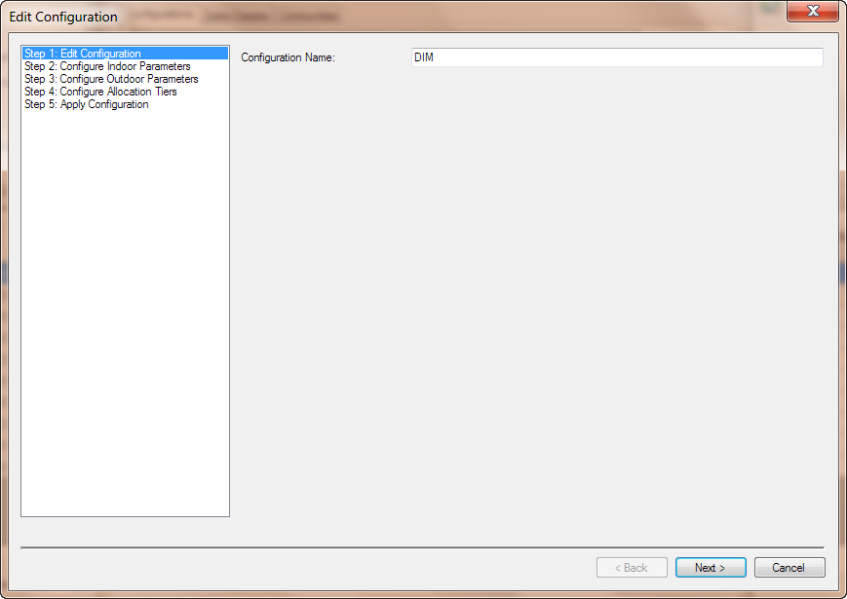
Software Upgrades
Configuration Wizard Added (Step 1)

Slide 27
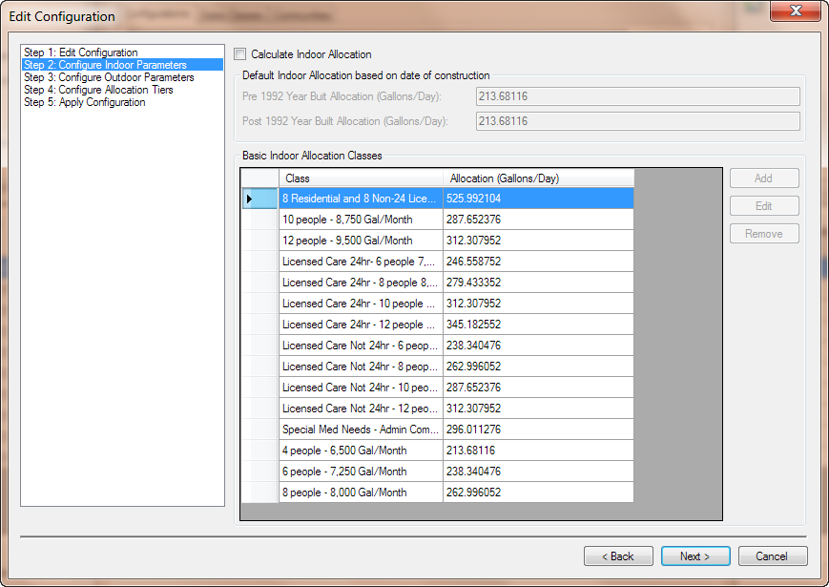
Software Upgrades
Configuration Wizard Added (Step 2)

Slide 28
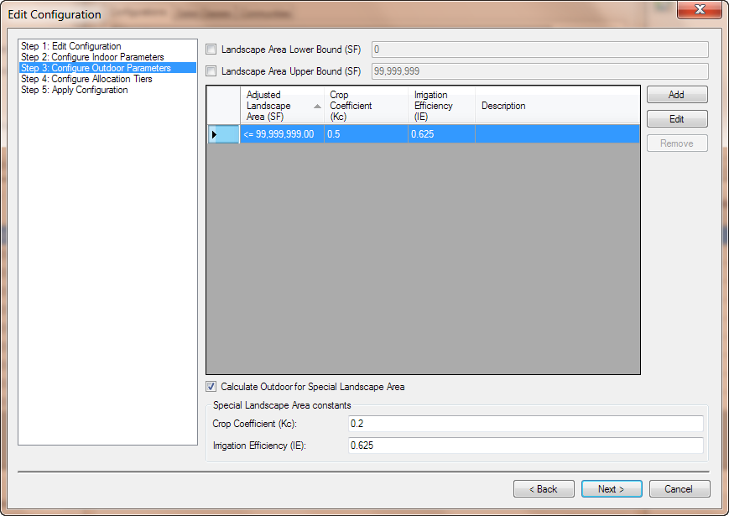
Software Upgrades
Configuration Wizard Added (Step 3)

Slide 29
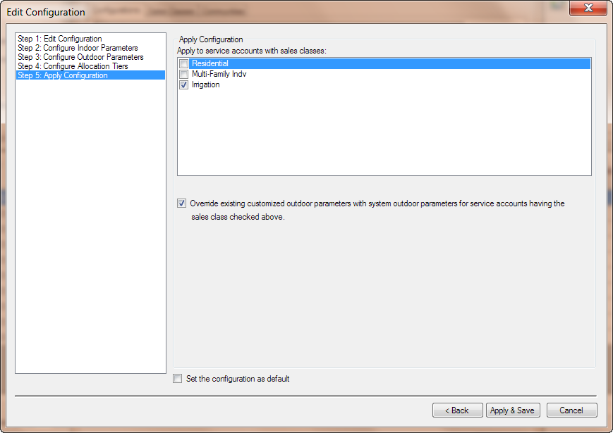
Software Upgrades
Configuration Wizard Added (Step 5)

Slide 30

CIS Integration

Slide 31
WaterSMART in Action

Slide 32
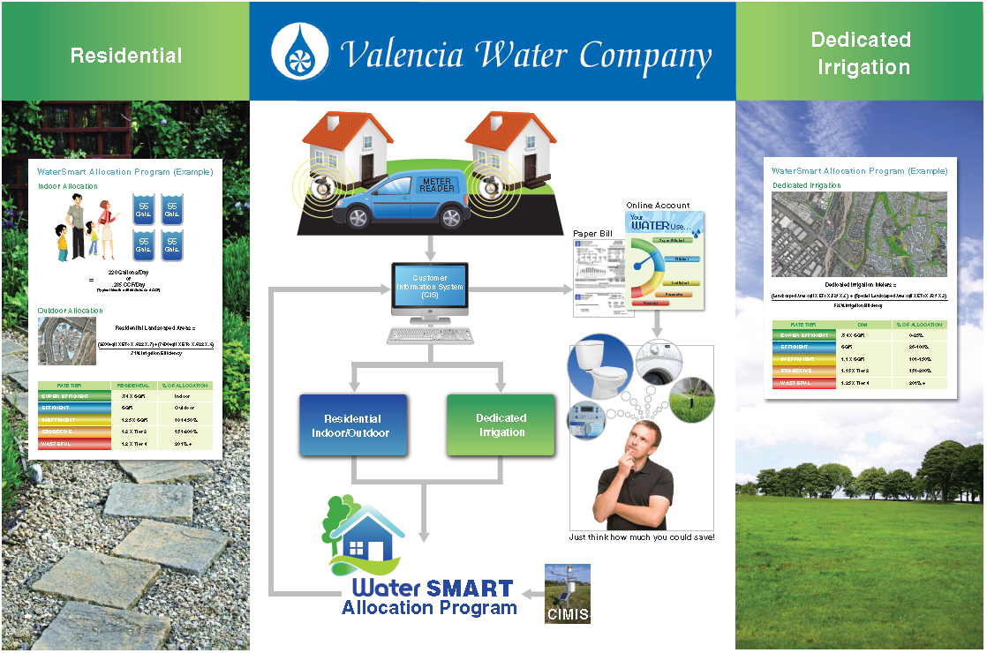
WaterSMART In Action

Slide 33
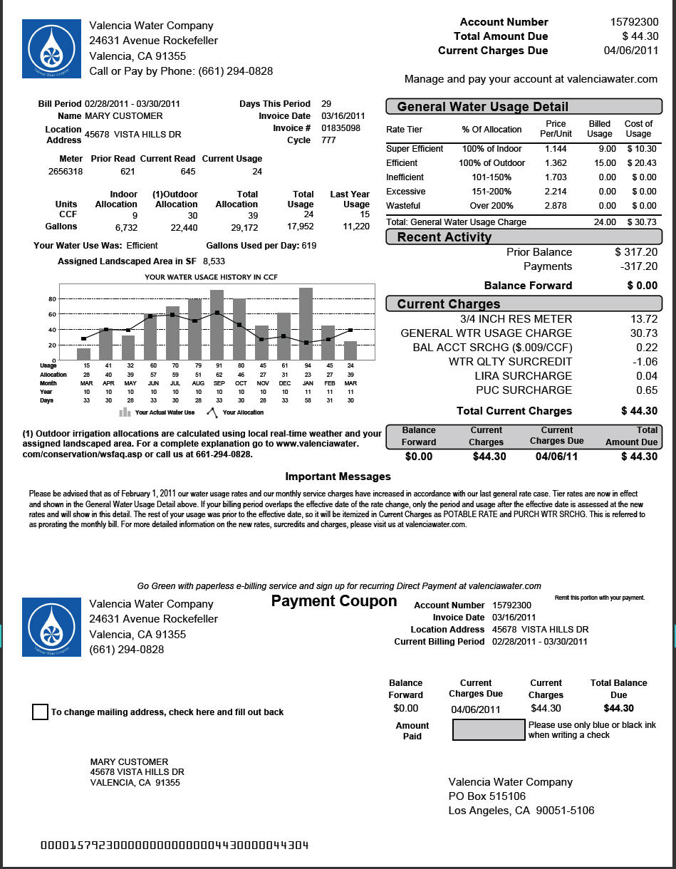
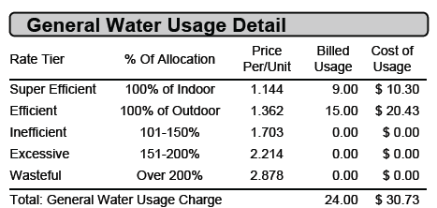
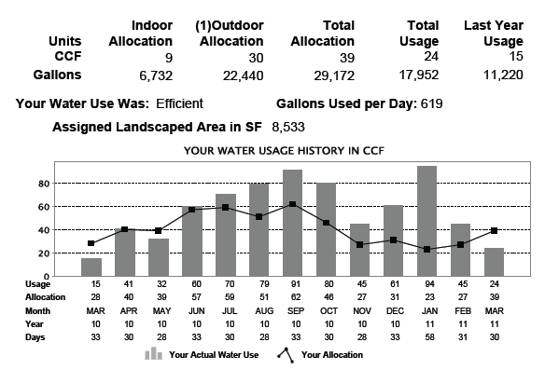
WaterSMART in Action

Slide 34
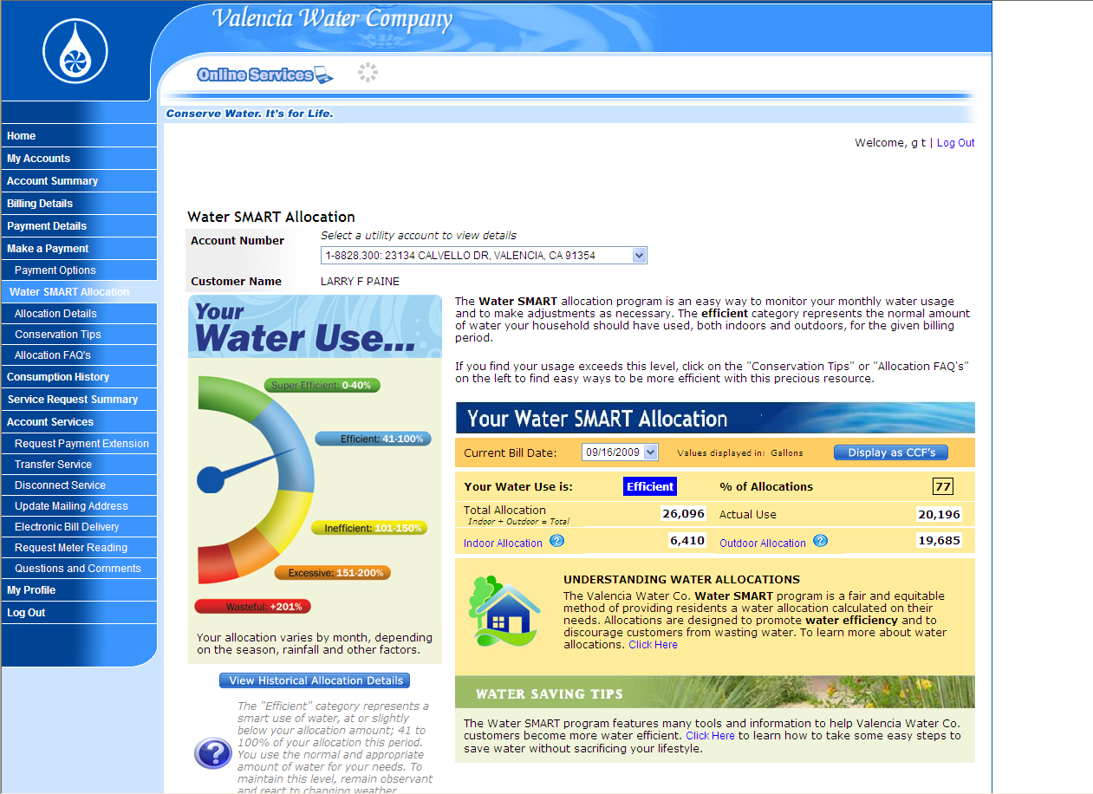
WaterSMART in Action

Slide 35
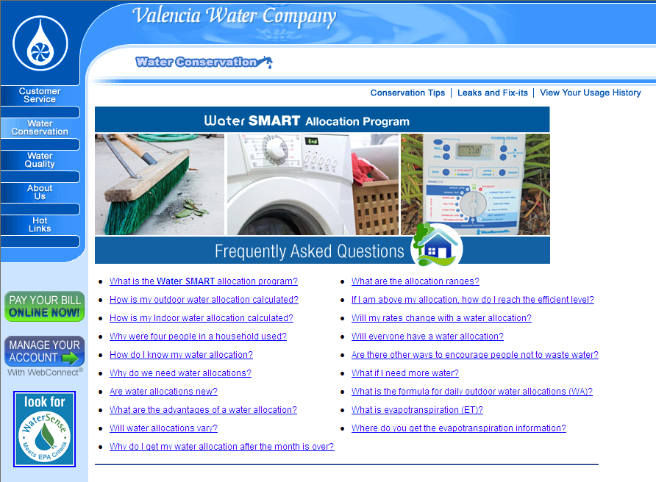
WaterSMART In Action

Slide 36
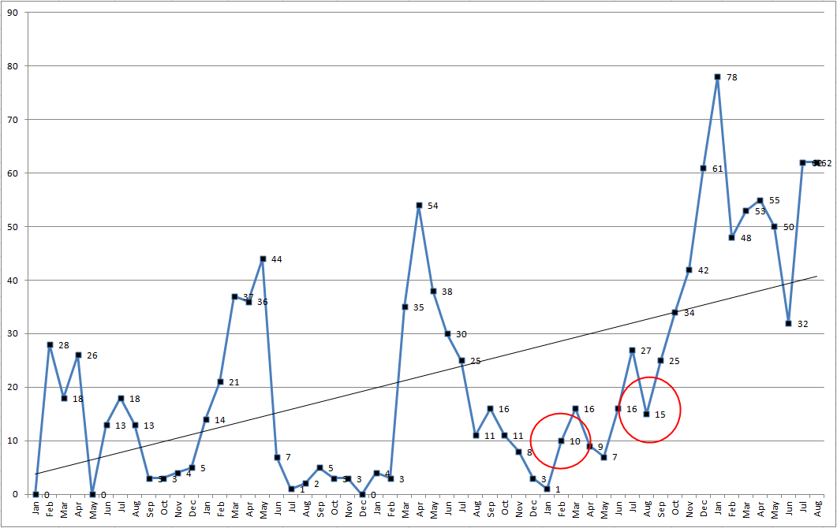
WaterSMART in Action
Completed Residential Water Audits by Month (2008 – 2012)

Slide 37
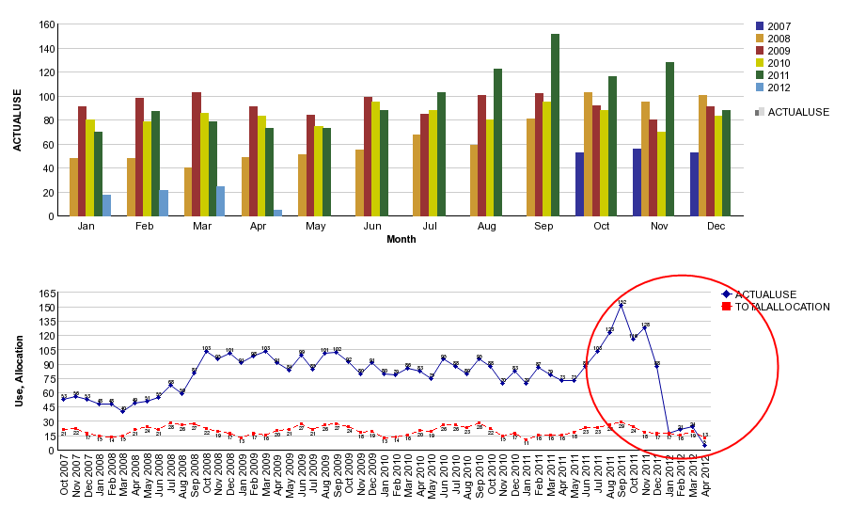
WaterSMART In Action
89,000 Gallons Saved Per Month!!!

Slide 38
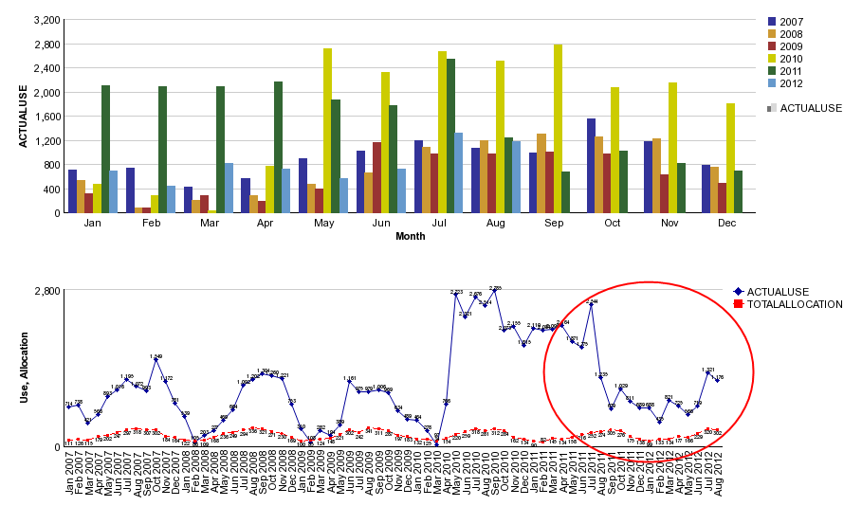
WaterSMART in Action
Over 17,000,000 Gallons Saved Since August 2011!!!

Slide 39

Future Tools

Slide 40
Future Tools
Integrate Additional Customer Classes
Management/Planning /Rate Design Tools
Spatial ET Data from CIMIS Web Site
AMI and Two-Way Communication Possibilities
  Real-time Response to High Water Use
  Time of Use Pricing
Reporting Features
  Customer Water Usage/Budget Report
  Key Performance Indicator (KPI) Report

Slide 41
Questions?
Matthew S. Dickens
Resource Conservation Manager
Valencia Water Company
661-295-6543
mdickens@valenciawater.com
Ming-Chin Jeng
Vice President
DCSE
949-465-3400
mjeng@dcse.com
Thank You!!!

