Slide 1
Communicating With Customers About Rates…. One at a Time
October 6, 2011

Slide 2
Challenge: Meet 20% by 2020
Water allocations
+
Tiered Rates
But……
Over 2 years
Community averaged landscapes then precise
Segmented audience
Notes:
Program, because of CPUC filings, would be rolled out over two years.
A great opportunity to reach, educate customers before tiered rates
Issue: Allocations not precise because averaging of landscaped areas by neighborhood
Increasing audience segmentation…. No longer a “one message fits all” approach

Slide 3
Goals: 5% variance requests Customer acceptance as “fair and equitable”
Solution:
“High Touch”
Outreach Plan
in collaboration with
Customer Service
Notes:
Aggressive goal – some SoCal water agencies had goals of 20% customer complaints and variance requests
Solution – a guerilla marketing effort.
High Touch service philosophy – much like a bank..
Inform them for a long time before you spring it on them..

Slide 4
Focus groups = strategy and key messages
Individualize it – “you” are in control
Simple adjustments gets into “efficient” range
“Wasting” water vs. “conserving” it.
Make customers feel…..
Notes:
Surround strategy. Make sure customers did not ignore the bill stuffer.
High-impact was important in Phase 2 (10,000 limitation, modifications to landscape area)
Focus groups told us customers felt they were smart, wanted to be treated as smart.. This was a “high tech” solution…

Slide 5
Customer Communications Plan Phase 1- Allocations only Phase 2 – Tiered Rates
News release
Public speaking engagements
Bill messages
Direct mail piece
Interactive website
(High-impact customer outreach in phase 2)
Notes:
Surround strategy. Make sure customers did not ignore the bill stuffer.
High-impact was important in Phase 2 (10,000 limitation, modifications to landscape area)

Slide 6
Phase 1 Direct Mailer #1 Front

Slide 7
Phase 2 Updates Customer Specific WebAccounts
Notes:
Special things that can not be seen on a customer bill due to space limits – things we added to webconnect
Can convert between ccf’s and gallons
Can do back and look at 24 months of history at a glance to see indoor and outdoor budgets shown separately
Quick access to Q&A

Slide 8
Phase 2 Updates Customer Specific WebAccounts
Notes:
Added two year history of WSA to actual

Slide 9
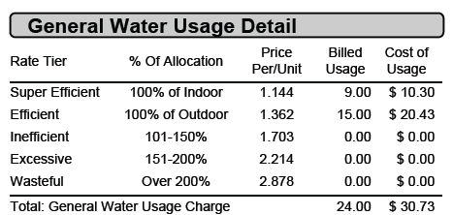
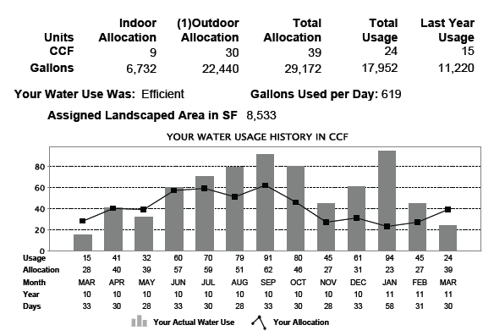
Phase 2 Updated Bill with Tiered Rates
Notes:
Right side of slide shows an expanded view of important WSA and Tiered Billing information

Slide 10
Continued Communication Efforts Bill Insert - Front Side
2011 Annual Bill Calculation Mailer

Slide 11
Continued Communication Effort Bill Insert - Back Side
2011 Annual Bill Calculation Mailer

Slide 12
Efforts included:
Rigorous training for Customer Service
Quick response
Personal visits to homes
Customer testimonials
Notes:
WSA and Tiered Rates new to VWC customers – I truly believe we need to touch each customer through a grass roots effort (fishing boat, lake house, social gatherings) – Once explained to a person they truly understand the equity of our program and effort it has taken to make equitable.

Slide 13
Continuous Outreach Efforts
Continuous Efforts Include:
Targeted Market Outreach
High Impact Customer Outreach Program
Monthly Abnormally Hi/Low vs. Allocation
New/Improved Conservation Programs
HELIUM Rebate Program - High Efficiency Landscape Irrigation Upgrade Measures
High Consumption Notification
Specialized Residential Audits
Complete Audit (Indoor and Outdoor)
Irrigation Only Audit
Leak Detection Assistance
Notes:
Matt

Slide 14
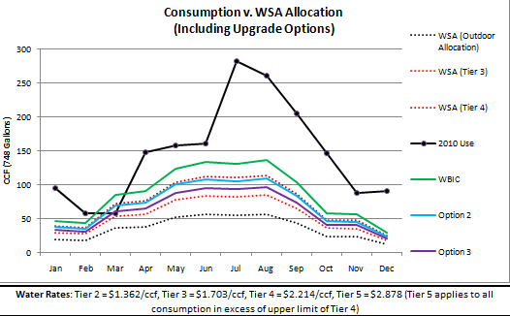
Continuous Outreach – Targeted Market
High Impact Customer Outreach Program
Customers with large landscapes and typical high consumption were contacted and offered the Residential Water Check-Up, WBIC Information and an assessment on Irrigation Improvement and turf conversion.
Notes:
Handout..

Slide 15
Continuous Outreach – Targeted Market
Monthly usage abnormally Hi/Lo vs. Allocation
Monthly Hi/Lo Usage Report
Monthly Hi/Lo Report enables Conservation Department to identify customers with either abnormal or persistent high consumption and offer assistance – examples of customer monthly usage below
Abnormal - Spike
Persistent Use
Notes:
Handout.

Slide 16
Water SMART Stats-2011
 | January | February | March | April | May
WS Inquiry Calls | 24 | 35 | 40 | 26 | 14
WS Rate Complaints | - | 0 | 0 | 0 | 0
WS Tier Names Compl | - | 0 | 1 | 0 | 1
Indoor Variance | 2 | 13 | 0 | 8 | 3
Outdoor Variance | 1 | 2 | 1 | 0 | 6
CPUC Complaints | - | 1 | 1 | 0 | 0
WS Full Water Audit | - | 7 | 17 | 10 | 1
WS Leak Audit | - | 0 | 0 | 2 | 0
2010 had total of 30 total WS Calls
Notes:
Notes to GM – Planned to roll out in winter when usage low so any $ impacts less severe. But lucky during roll out of tiered rates that it was rainy and also start of summer unusually cool.
VWC customers turn or reduce sprinkler run times in winter and do not turn sprinklers “up” based on calendar…they wait until it gets hot (and forget to reduce in Fall)

Slide 17
Summary of Water SMART Allocation Program Philosophy
Staff Preparation
Fair and Equitable Program
Communication
Program Acceptance

Slide 18
Questions
Matthew S. Dickens
Valencia Water Company
(661)295-6543
mdickens@valenciawater.com
Denis Wolcott
(213) 200-1563
denis@thewolcottcompany.com

