Slide 1

STATEWIDE DROUGHT RESPONSE: IMPACT TO SOUTH ORANGE COUNTY
Joone Lopez
General Manager
Moulton Niguel Water District
April 21, 2016

Slide 2
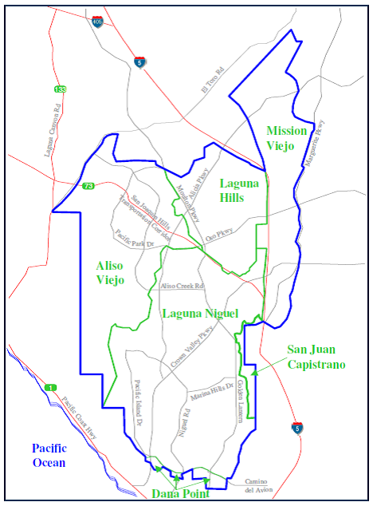
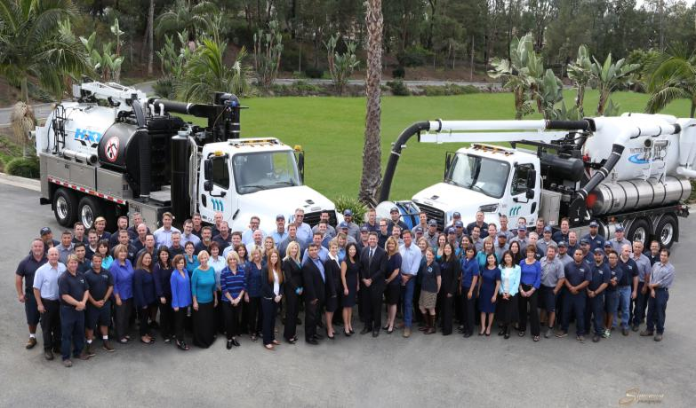
MNWD: A Quick View
Service:
Water,
Wastewater,
Recycled Water
Average
Annual Demand: 27,000 AF
Population: approx. 175,000
Drought Impact: 20%
Recycled Water: 25% of demand

Slide 3

Timeline: Drought Snapshot
1/2014: Statewide Voluntary Reduction
4/2015: Executive Order Issued
6/2015: Statewide Emergency Regulations
2/2016: Extension of Regulations
5/2016: Initiate Long Term Framework Development

Slide 4

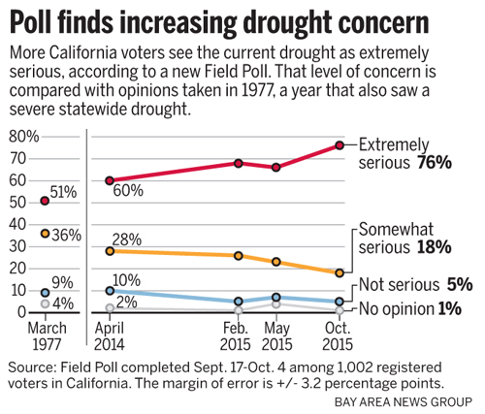
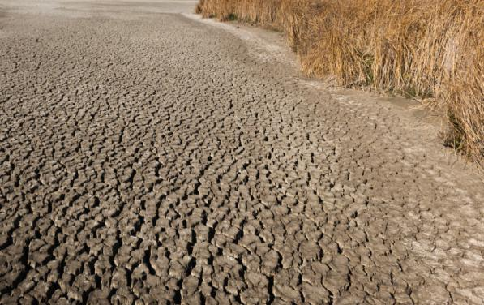
Our Reality: Post 2014
Emergency Regulations
Penalty/fines
Long Term Framework
State/Federal Legislation
Financial Impact
Drought: Global Problem

Slide 5
Response & Results: 2014-2016
Customer Communication
Rates
Water Shortage Contingency Plan
Restrictions
Technology
Partnerships
MNWD Conservation by the Numbers
More than 1 billion: | Gallons saved since June 1, 2015
95 percent: | Customers’ usage within budget
25 percent: | Roughly the amount of countywide turf replacement projects completed by MNWD customers
2015: | Lowest water usage year since 1991, despite serving 80,000 new customers
25% Reduction in CA Urban Use
South OC Agencies Meeting Reduction Targets

Slide 6
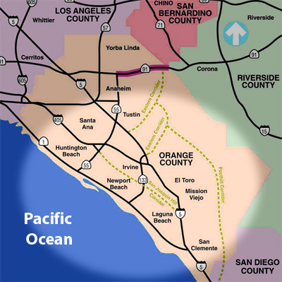
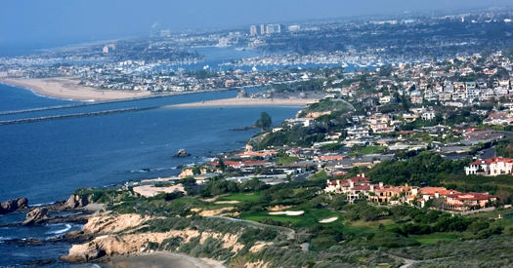
Impact: South OC
Financial Impact
Resource Needs
Political Impacts
Economic Development
Public Awareness
Outdoor Transformation

Slide 7
Drought: Status

Slide 9


Look Ahead: Challenges
Ensure Safe & Reliable Water for All
Accessibility for All Communities
Support Economic Health of CA
Remain Relevant & Proactive
Maintain Public Trust

Slide 10

Bottom Line: Striking a Balance
Local control – Statewide problem
Statewide application - Not a one size fits all
More we know - More obligation
What’s needed – What can be done
Demand Management
Local Supply Development

Slide 11
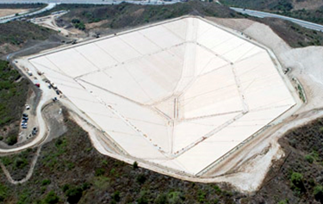
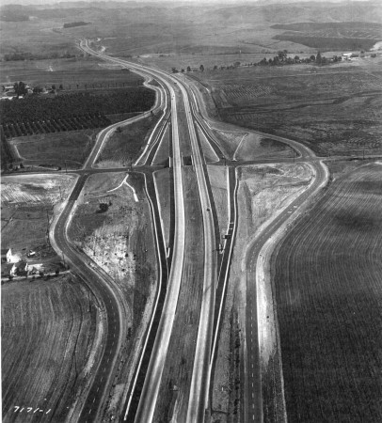
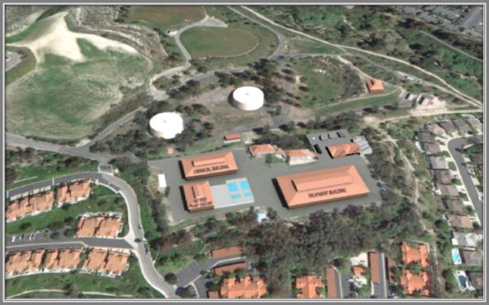
Reliability: Supply/System Projects
$70 Million: Investment in last 8 years
Upper Chiquita Reservoir
IRWD Interconnection
Baker Water Treatment Facility
Research Ocean Desalination
San Juan Basin Recharge/IPR
Planning:
Long Range Reliability Plan
Long Range Financial Plan
Recycled Water Master Plan

Slide 12
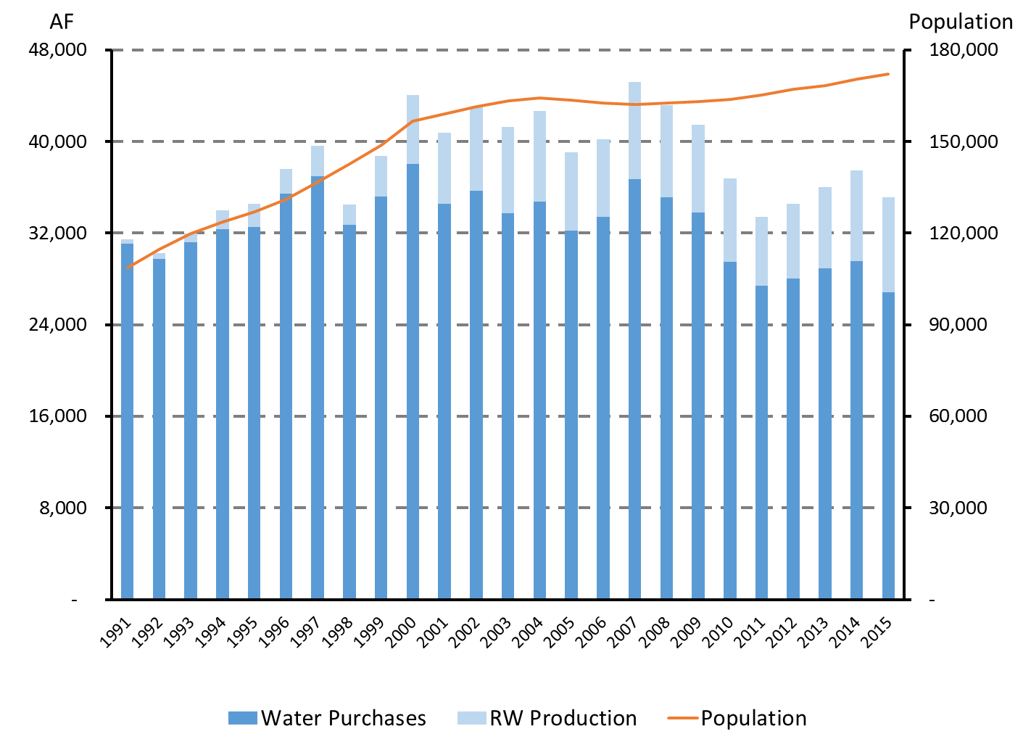
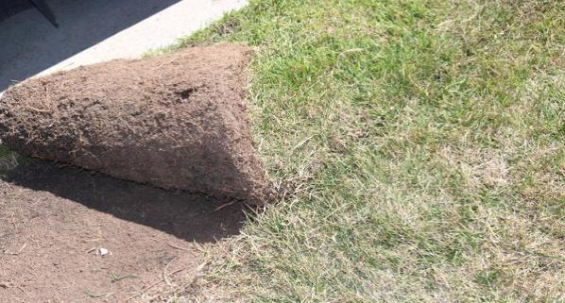
Reliability: Demand Management
23% Reduction in total demand since peak in 2007
Population Demand
Water Budget Based Rates
Conservation/WUE Programs
4 million sq. ft.
Turf removed
Drought Response:
Outdoor Transformation
Communication
Water Shortage Contingency Plan

Slide 13
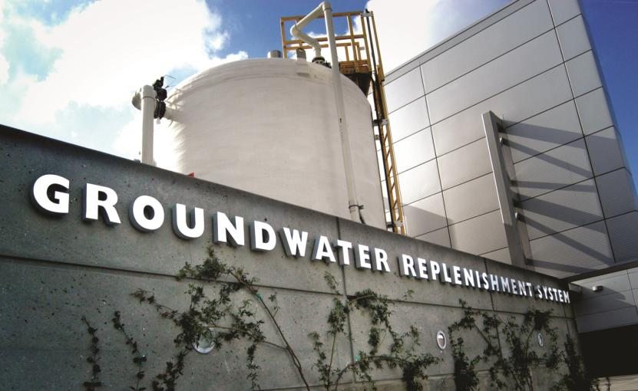
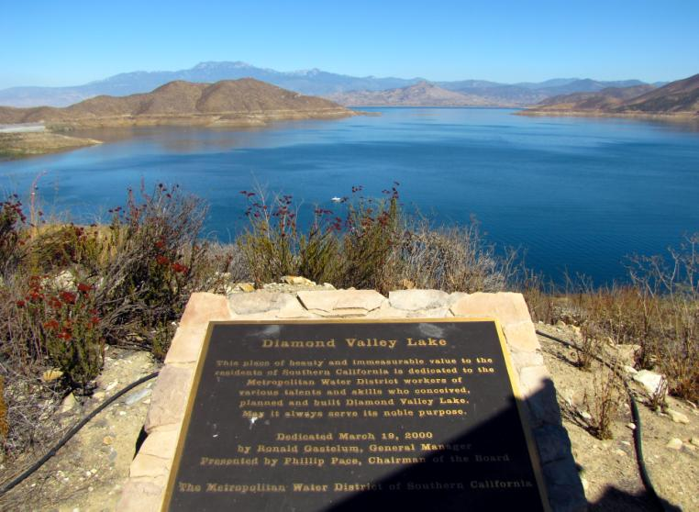
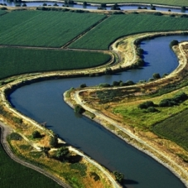
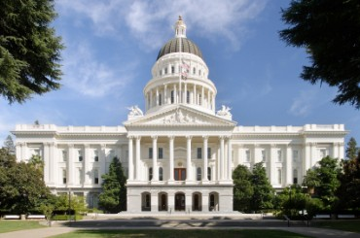
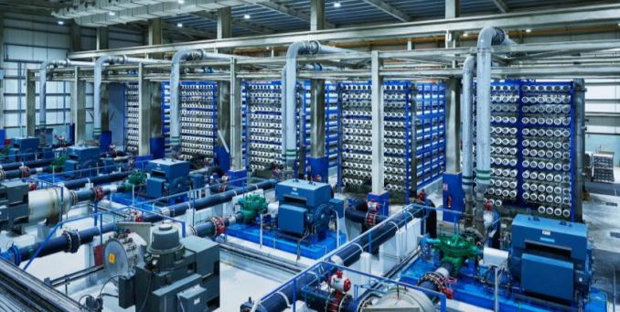
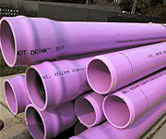
Path to Reliability: Integration

Slide 14





Path to Reliability: Innovation
Answer the call for improvements in CA’s water data infrastructure
Integrate customer-level water usage data across to develop measurements of water usage behavior and illustrate how this effort can scale statewide.
Phase One Pilot Partners:
East Bay Municipal Utility District
Eastern Municipal Water District
Inland Empire Utilities Agency
Irvine Ranch Water District
Las Virgenes Municipal Water District
Moulton Niguel Water District
Metropolitan Water District of So CA
Santa Margarita Water District

Slide 15


For Our Constituents: What It Means
It’s NOT About the Drought
Value of Water
Water is About PEOPLE Not Principles
Note Use Less; Waste Less
New Era in Water
Responsible Actions

Slide 16
Thank You
Joone Lopez
General Manager
Cell: 949-444-6994
jlopez@mnwd.com
Drew Atwater
Water Resources Manager
datwater@mnwd.com

