Slide 1
ACWA 2016 SPRING
CONFERENCE & EXHIBITION
May 4, 2016 Monterey, CA
Communicating a Rate Structure Change
Amidst a Drought and Prop. 218 Challenge
Carlos G. Reyes, P.E.
Director of Resource Conservation and Public Outreach

Slide 2
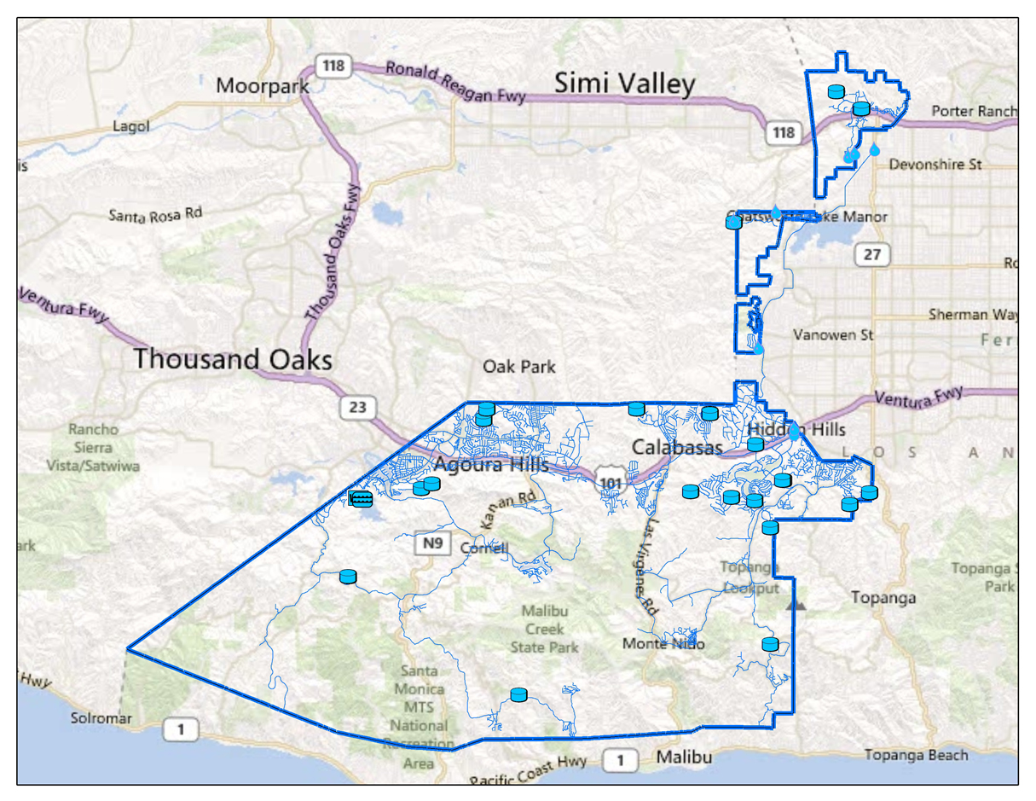
LVMWD Service Area

Slide 3
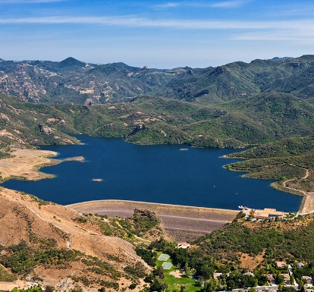
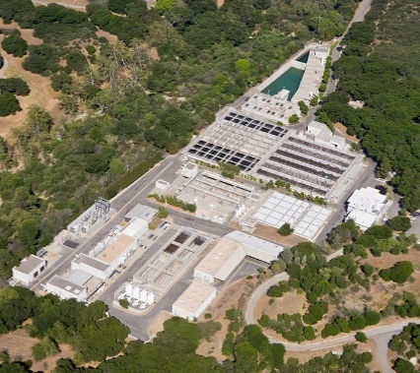
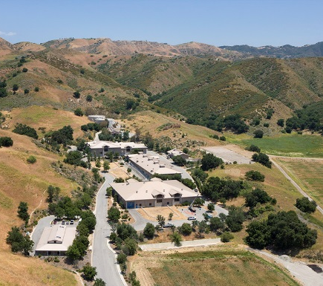
LVMWD Services
Provide reliable and high quality-
Potable water service
Wastewater treatment
Recycled water service
Biosolids composting

Slide 4
Implementing water budgets -
Is not easy!
Needs Board support and staff commitment
Requires a comprehensive Outreach Plan
Requires community/group and personalized customer outreach
Requires consistency in your messages
Requires keeping your sense of humor

Slide 5
3x/week

Slide 6
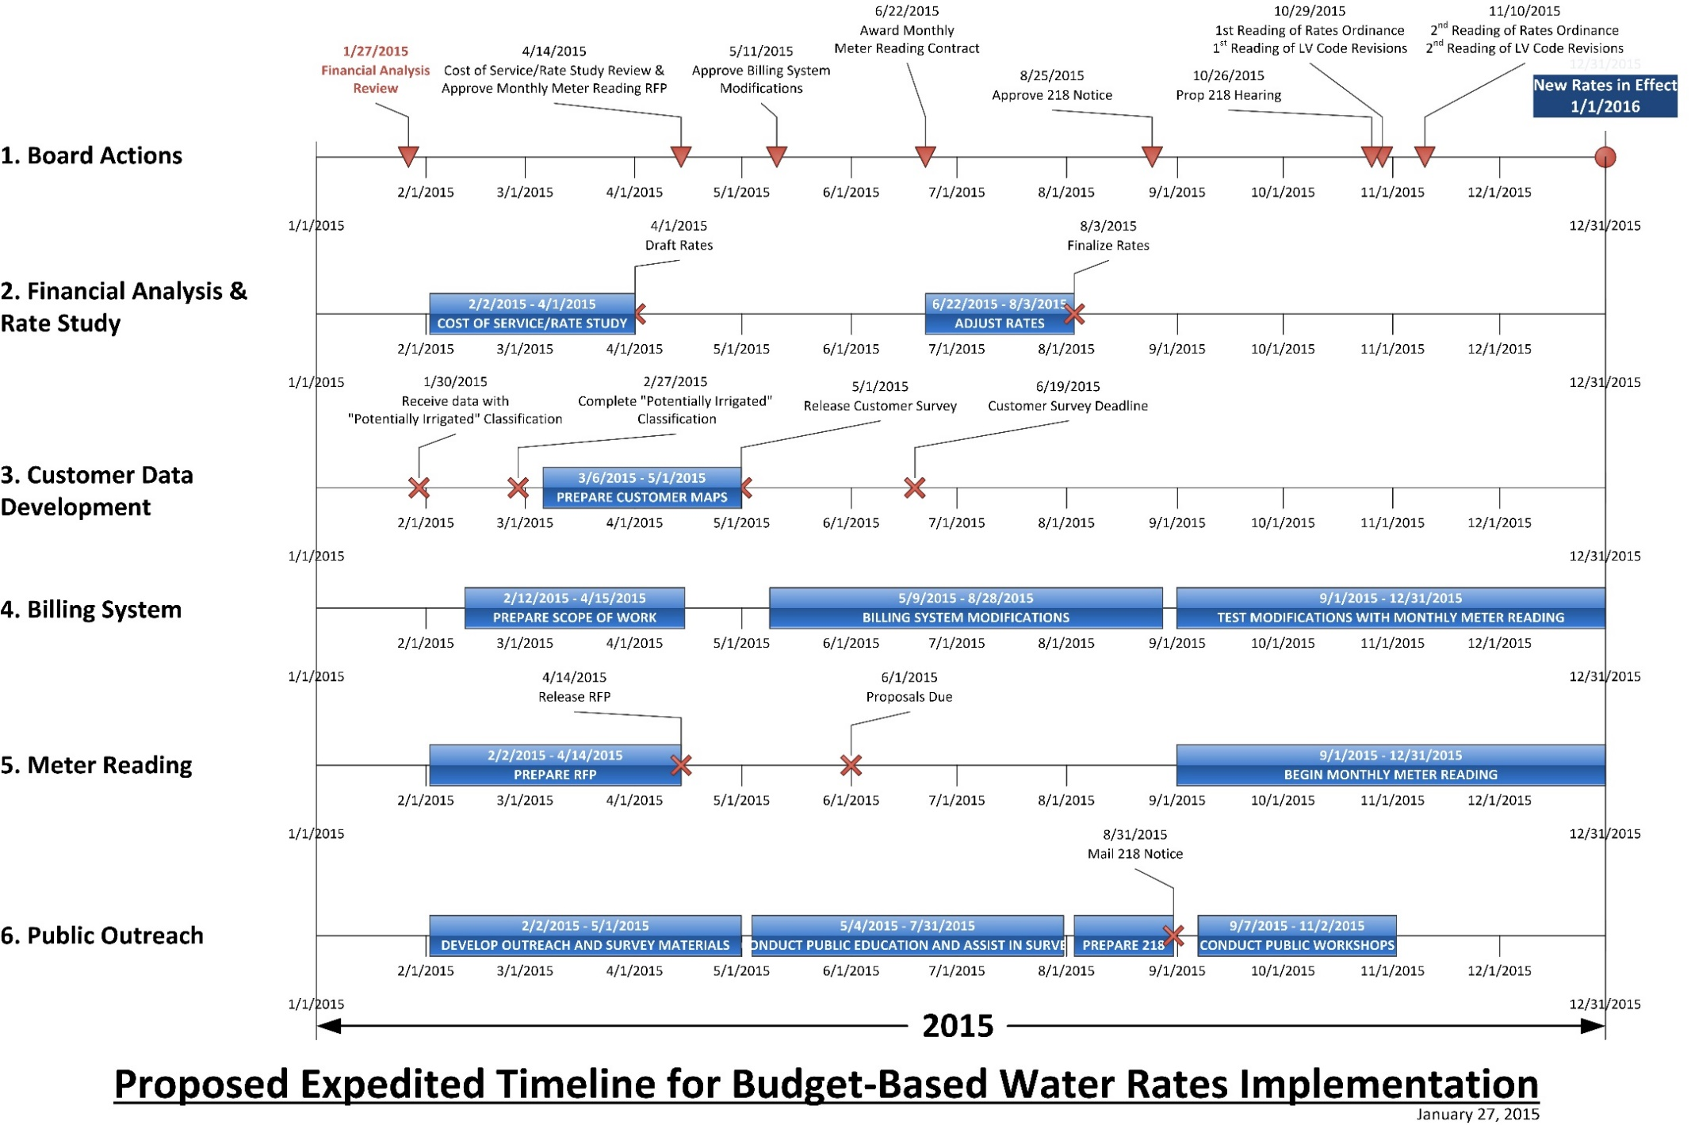
2x/week
1x/week

Slide 7
Outreach Plan
January – April “Introduce the Concept”
Build public awareness through speaker’s bureau, newsletter, website
Develop brochure & questionnaire content
Develop FAQ for website
Schedule presentations for HOAs and service clubs
April – August “Community/Group Outreach”
Handouts at community outreach events
Speaker’s Bureau presentations
Presentations to City Councils
September “Personalized Outreach”
Schedule Public Workshops throughout service area
Develop draft Prop 218 Notification

Slide 8
Outreach Plan
September – October “Public Workshops”
Mail Prop 218 notice
Public workshops in each District division, use appropriate examples for each event
Conduct Focus Groups (if necessary)
October – November “Public Notification”
Continue emphasis on response to Customer Data Development
Schedule and conduct a Saturday “Open House”
Prepare information on monthly billing
November - December 2016 “Rollout”
Announce Board actions on rate adoption (conclusion of 218 process)
Advertise / promote new billing system
Consider scheduling a Saturday “customer assistance event” at HQ prior to rollout

Slide 9
Community/Group Outreach
Intergovernmental meetings
Homeowners associations
Chambers of commerce
Community groups
Informational community meetings
Landscapers
Newsletters
Local television
Press releases
Website
Social media
Newspaper ads

Slide 10
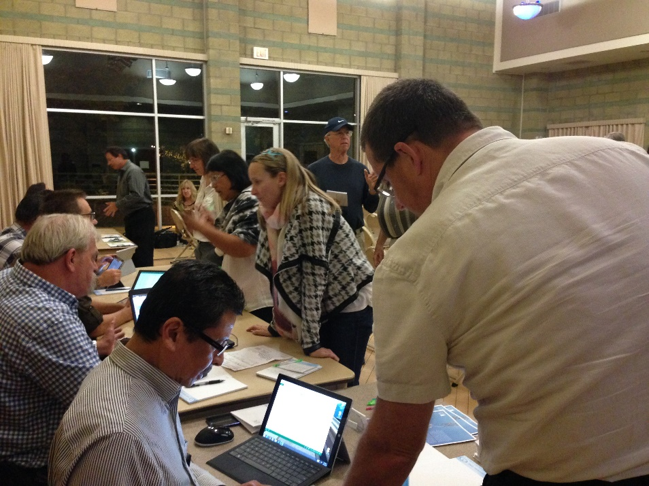
Personalized Outreach
One-on-one customer consultation
Website
Comparison of “tiered” vs “water budget” rates
Individualized water budget estimator
Questionnaires
Site visits
Customer meetings at the
District

Slide 11
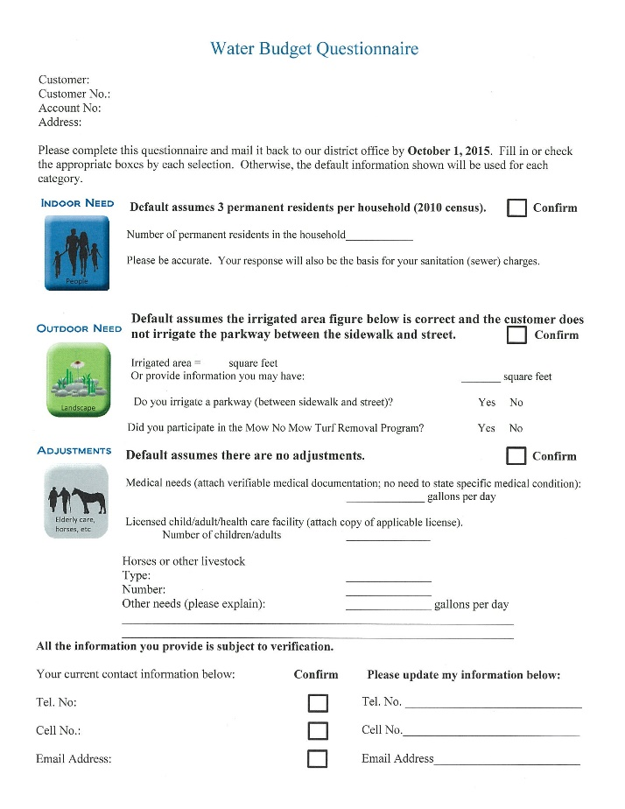
Questionnaire
Number of residents
Irrigated area
Adjustments
Updated contact information
Telephone number
Cell phone number
Email address

Slide 12
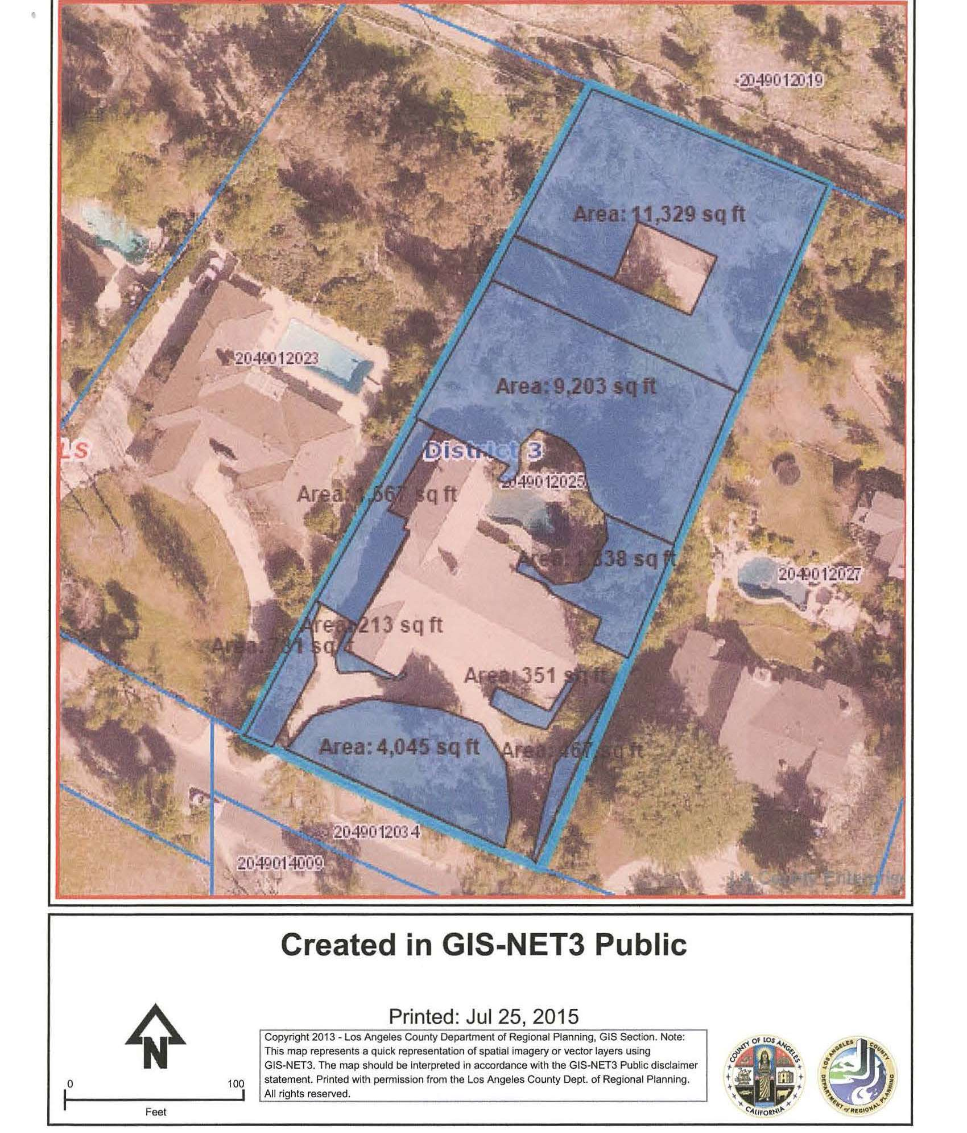
Customer Response
Customers used the LA County Regional Planning GIS website to determine their irrigated areas.

Slide 13
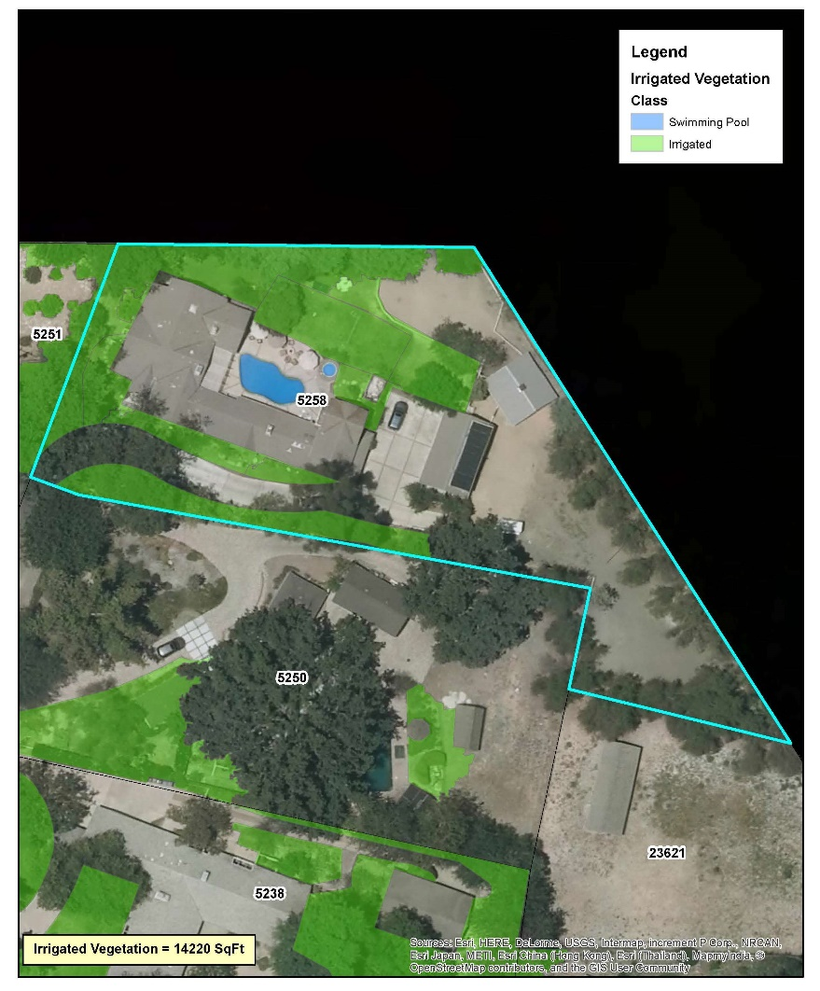
“Go the extra mile…”

Slide 14
Results
Only five letters received during the 218 comment period.
The number of customer email addresses doubled as a result of the questionnaire.
Customer calls have increased, but are manageable.
District implemented the program without hiring additional staff.
New rate structure is going to it 4th cycle of monthly billing.

Slide 15
Summary
A multi-pronged outreach strategy is important to promote understanding of a budget-based rate structure. Use every means of outreach possible.
Be prepared to spend time with the ratepayers, one customer at a time. It goes a long way to getting program support.
The job is not done after the first bills are sent. Recognize that customer education and data development are ongoing processes.

Slide 16
Questions…..

