Slide 1
ACWA 2016 SPRING
CONFERENCE & EXHIBITION
May 5, 2016 Monterey, CA
Implementing Budget-Based Rates
Amidst a Drought and Prop. 218 Challenge
Carlos G. Reyes, P.E.
Director of Resource Conservation and Public Outreach

Slide 2
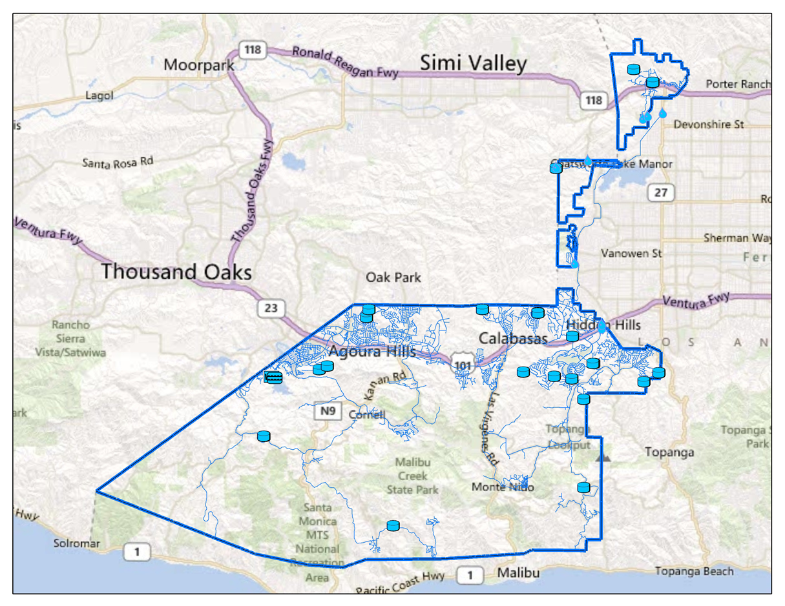
LVMWD Service Area

Slide 3
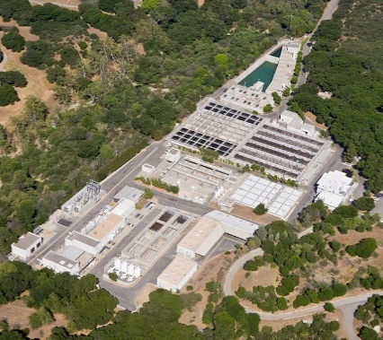
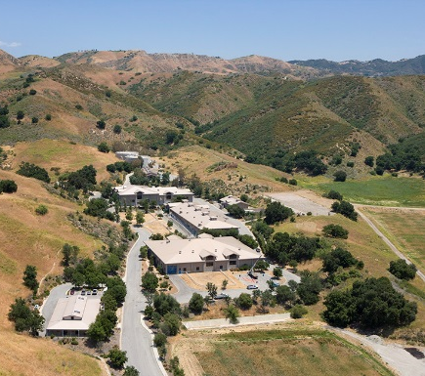
LVMWD Services
Provide reliable and high quality-
Potable water service
Wastewater treatment
Recycled water service
Biosolids composting

Slide 4
3x/week

Slide 5
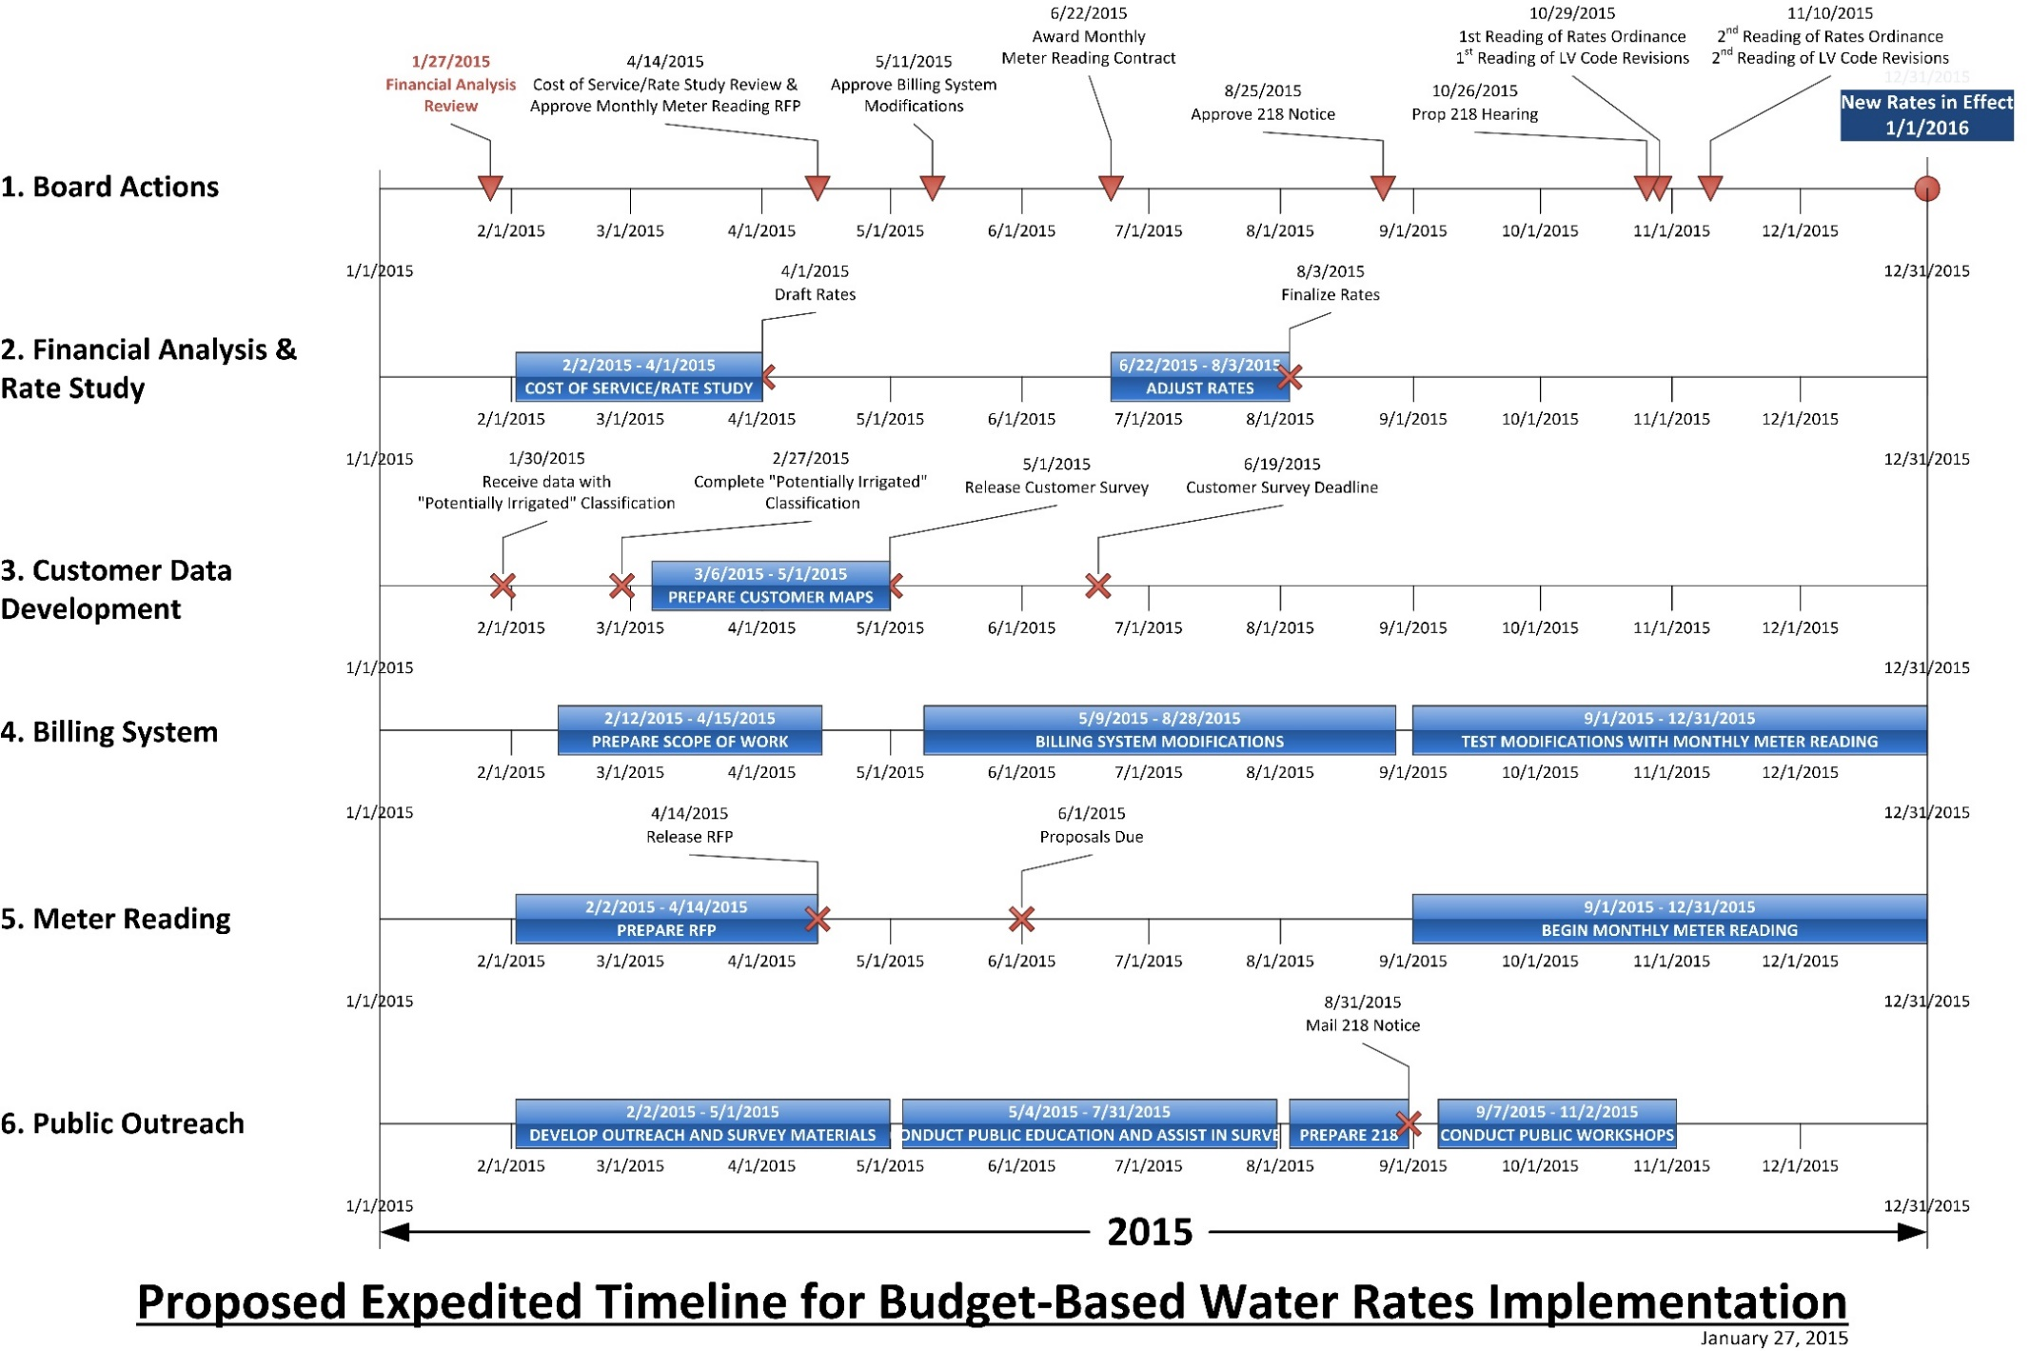
2x/week
1x/week

Slide 6
Guiding Principles for Rate Setting
Rate structure must be fair and equitable.
Provide revenue and rate stability for LVMWD.
Price structure set to drive efficiency ethic.
Minimize impacts to efficient customers.
Comply with Proposition 218.

Slide 7
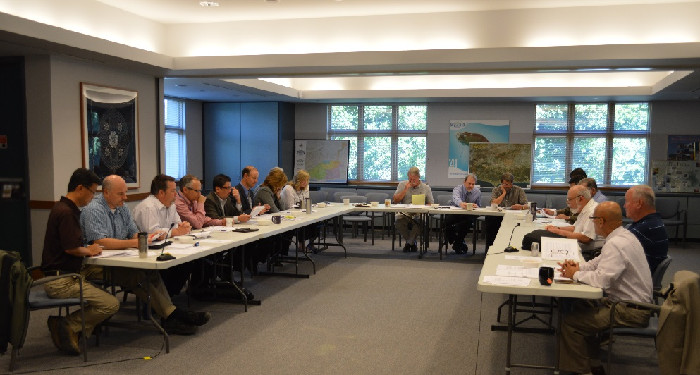
A Transparent Process
Public meetings
Public workshops
Outreach to cities, HOAs & community groups
Direct mail to all customers
Customer questionnaire
Public Hearing on October 26, 2015

Slide 8
Past Rate Structure - Tiered Rates
Tier 4
Tier 3
Cost
Tier 2
Tier 1
Use

Slide 9
Water Budgets
Over 150%
of Water Budget
Water Budget
Excessive
101% to 150%
Of Water Budget
Inefficient
Cost
Efficient Outdoor Use
Efficient Indoor Use
Use

Slide 10
Potable Water Charges
“Readiness to serve” charge increased to recover more fixed costs.
Commodity charges reflect costs of importing, treating and delivering water.
Elevation charges reflect increased cost of pumping to higher locations.
Higher tiers reflect costs created by those users.

Slide 11
Recycled Water
Water is water!
Water budget structure to promote efficient use.
“Readiness to serve” charge added to enhance revenue stability.

Slide 12
Sanitation Rates
A “per-person” rate structure adopted for all residential customers.
Maximum charge is for a household of 6 people.
Some households will see a decrease.
Sanitation rates assume a “reasonable” NPDES permit for Tapia Water Reclamation Facility.

Slide 13
Website Tiered Rates vs. Budget-Based Rates Comparison

Slide 14
Wasteful Usage Penalties
Resolution No. 2468 established an administrative penalty structure for “wasteful” use that is more than 200% of a customer’s water budget.
1st offense – written warning.
2nd offense – penalty of $2.50 per unit of water.
3rd+ offense(s) – penalty of $5.00 per unit of water.

Slide 15
Website Water Budget Calculator

Slide 16
Implementation
September 2, 2015: Prop. 218 notice released; five letters received.
October 26, 2015: Approved rates.
November 25, 2015: Adopted Policy for Water Budget Adjustments.
January 12, 2016: Lifted irrigation restrictions.
February 2016: Billing under new rates began.

Slide 17
Next Steps
Refine customer data.
Implement billing system improvements.
Develop focused outreach program for “inefficient” customers.
Continue customer education.
Analyze revenues vs. projections during rate study.
Make program adjustments as necessary.

Slide 18
Questions…..

