Slide 1
Drought Planning Through Integrated
Rate Design
Drew Atwater
Water Resources Manager
Moulton Niguel Water District
October 8, 2015

Slide 2
Agenda
District background
Historical demand management actions
Components of integrated rates
Rate design
Drought Actions
Results
What’s next?

Slide 3
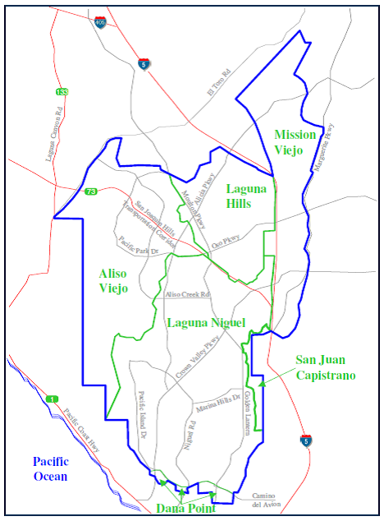
About MNWD
Water, recycled water & sewer service
  170,000 people
  5 Cities in South Orange County
100% dependent on imported water
  MWD (≈ 29,000 AFY)
Recycle Water ≈ 25% Total Demand
Annual budget: $126 M
Key revenues:
  Rates
  Property tax

Slide 4
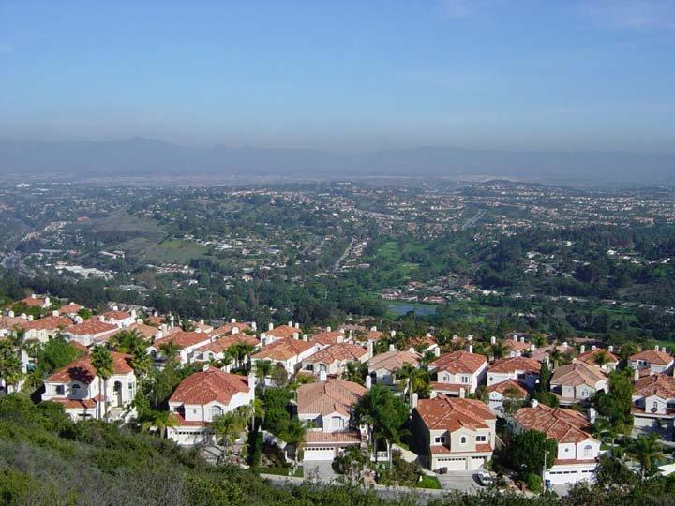
Service Area Snapshot
Residential
Median Household Income ~$150,000

Slide 5
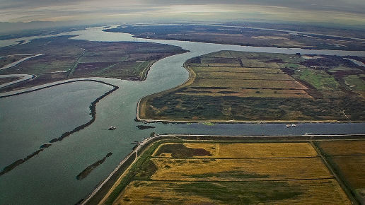
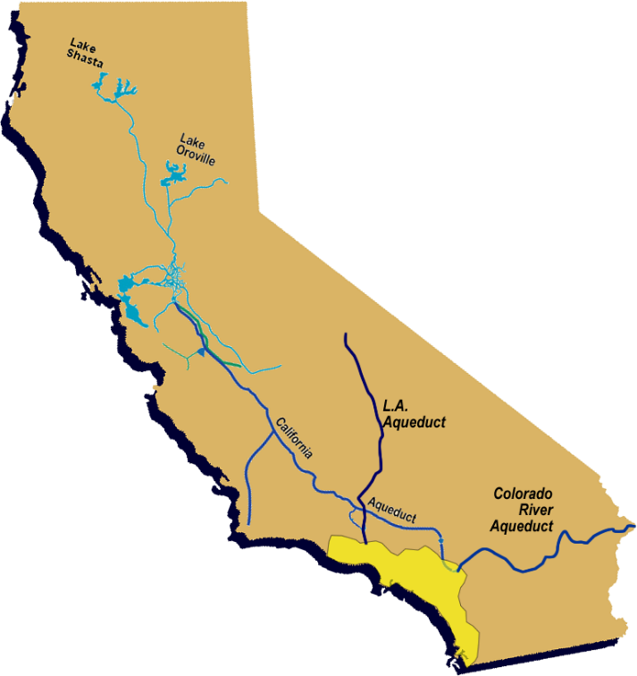
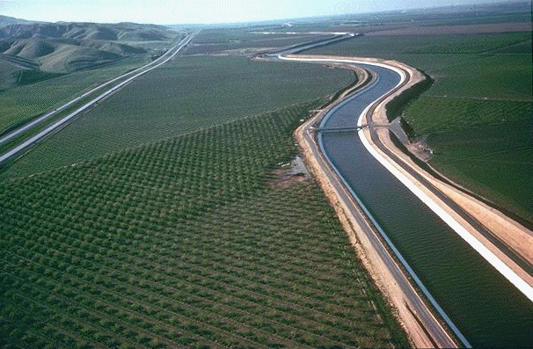
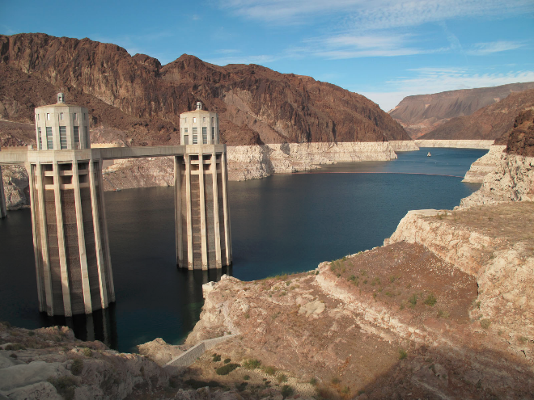
Water Supply
Sierra Mountains
Delta
State Water Project
Colorado River Aqueduct
Moulton Niguel Water District

Slide 6
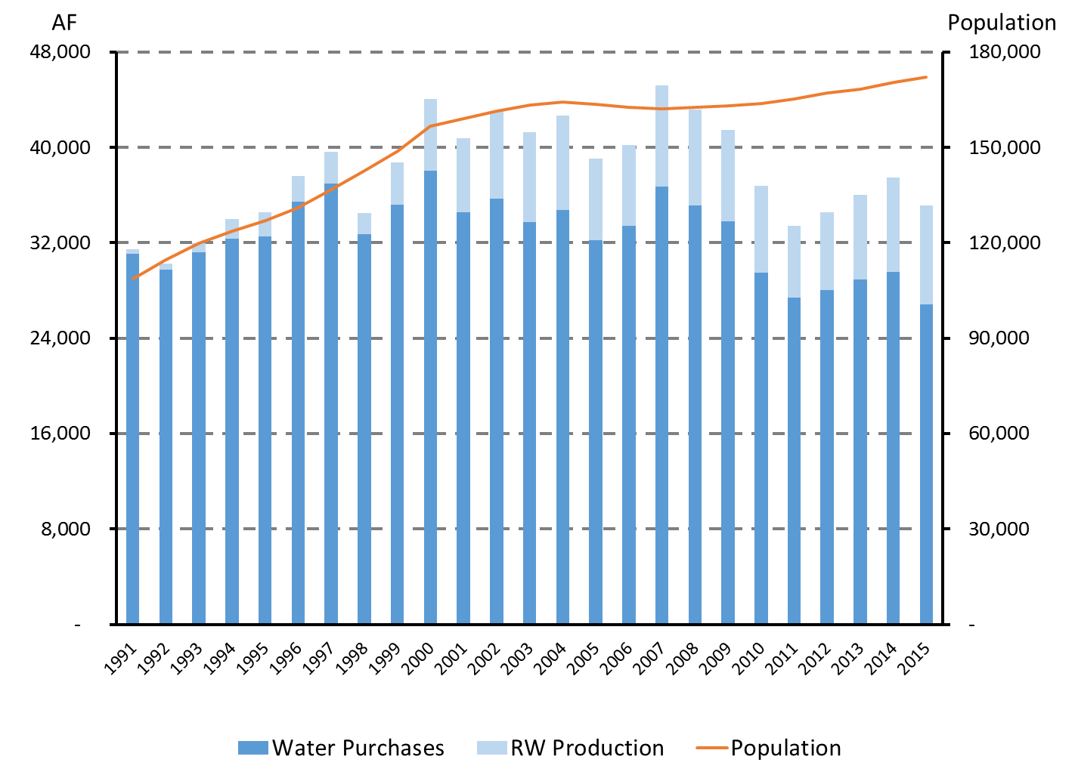
Demand Management Efforts
Water Budget Rates Implemented
2015 = Lowest potable water use since 1990
25% Recycled Water

Slide 7
Rate History
7 annual rate increases in the past 30 years
Water Budget Based Rates implemented in 2011
  2009 Drought enforcement experience
  Need for demand management tool
Adopted new rates Feb. 11, 2015
7

Slide 8
Components of Integrated Rates
Drought planning
Behavioral change
Prop. 218
Marketing
Capital intensive industry
Local agency outreach
Internal coordination

Slide 9
What is a Water Budget?
Allocation of usage based on characteristics that impact demand
Example:
  Indoor Allocation
    Household Size
    Efficient Indoor Use (45 to 75 GPCD)
  Outdoor Allocation
    ET (Seasonal, Historical Monthly, Actual Districtwide, Actual by microzone)
    Irrigable Area
    Crop Coefficient & Irrigation Efficiency
Notes:
Staff review – several internal workshops along with additional subgroup meetings
Review started with why we even started?
Including rate setting model, allocation calculations, variance procedures, rebate program, outreach efforts
Program Evaluation – Where and how has the program been effective; What challenges have been identified

Slide 10
Indoor Allocation Methods
Household Size
  Default = Census
  Variances
Determine Efficient Indoor Usage
  Average ~ 60 GPCD
  SBx7-7 = 55 GPCD
Notes:
Staff review – several internal workshops along with additional subgroup meetings
Review started with why we even started?
Including rate setting model, allocation calculations, variance procedures, rebate program, outreach efforts
Program Evaluation – Where and how has the program been effective; What challenges have been identified

Slide 11
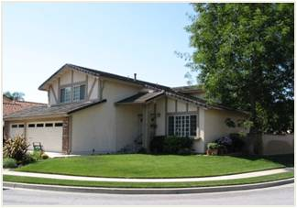
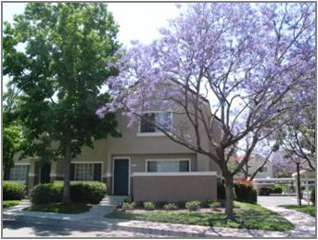
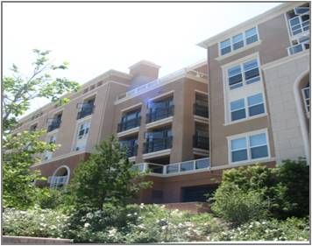


Ex: Indoor Water Budget
Single Family Residence Attached Home – Condo Apartment
Single Family Residence Attached Home – Condo Apartment
45 - 75 Gallons Per Person Per Day
Notes:
Staff review – several internal workshops along with additional subgroup meetings
Review started with why we even started?
Including rate setting model, allocation calculations, variance procedures, rebate program, outreach efforts
Program Evaluation – Where and how has the program been effective; What challenges have been identified

Slide 12

Landscape Allocation Methods
Based on landscape area
Plant water needs
Adjusted for climate (evapotranspiration – ET)
12
Notes:
Staff review – several internal workshops along with additional subgroup meetings
Review started with why we even started?
Including rate setting model, allocation calculations, variance procedures, rebate program, outreach efforts
Program Evaluation – Where and how has the program been effective; What challenges have been identified

Slide 13
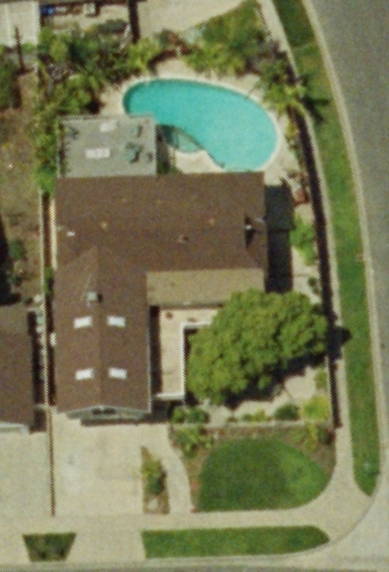
EX: Single Family Detached Home
Single Family Residence:
4 people
+
Outdoor Allocation:
Irrigated area -GIS mapping
Seasonal needs - ET
Warm season turf
71% irrigation efficiency
+
Variances Available:
Pool
Additional occupants
Medical needs
Others (livestock, etc.)
Notes:
Joone

Slide 14
Water Budget VS. IBR
Inclining Block Rate = Average Allocations
  Efficient Solution but Ignores Distributional Effects
  Ex: Large lots need more water- under-allocation
  Ex: Small lots need less- over-allocation
Water Budget = Individual Allocations
  Sends market signal to use at efficient level
Notes:
Staff review – several internal workshops along with additional subgroup meetings
Review started with why we even started?
Including rate setting model, allocation calculations, variance procedures, rebate program, outreach efforts
Program Evaluation – Where and how has the program been effective; What challenges have been identified

Slide 15
Rate Design Considerations
Which Tier(s) have demand response?
Supply MC?
Where is usage relatively constant?
To use fixed cost in low tiers or not?
Careful with allocating fixed costs in high tiers
  Water Budget incentivizes conservation
  Demand reduction w/ fixed costs in high tiers creates financial strain

Slide 16
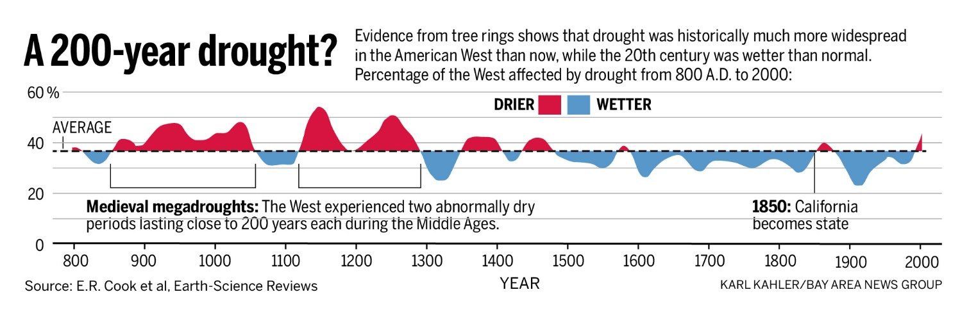
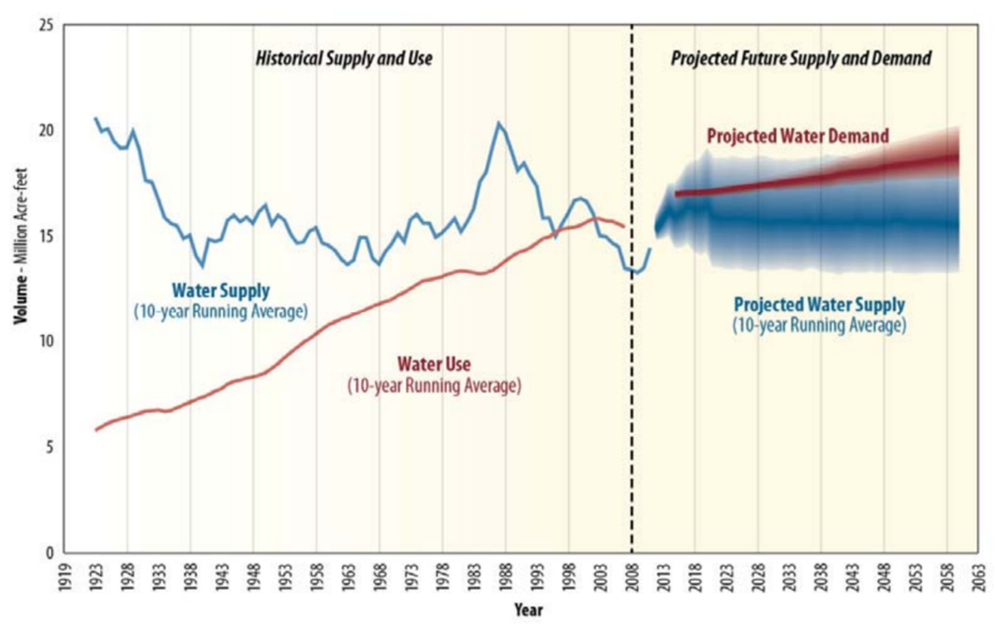
Why worry about volatility?

Slide 17
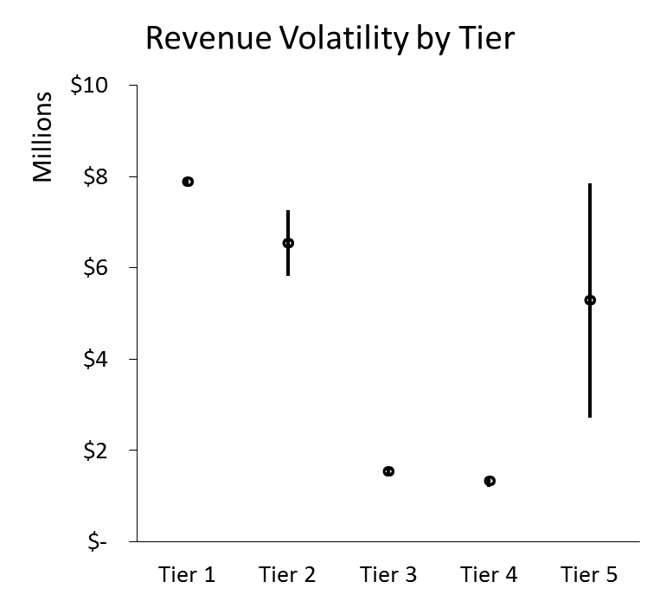
Planning for Volatility
Lower Tier 1 from 65 to 60 GPCD
Tier 2 with Rate Stabilization Reserve
Tier 3, 4, & 5 set at price of water
0.5%
49%
11%
7%
8%
= Average Annual Revenue 2011 to 2014 by Tier
= Standard Deviation of Annual Revenue 2011 to 2014
Notes:
Assessment Approach – How did staff approach the rate structure assessment?
Review the Rate Structure – What is it? How does it work? How are allocations calculated?
History of the Implementation – Assessment and Review of why the system was implemented; overview of the timeline
Program Evaluation – Where and how has the program been effective; What challenges have been identified

Slide 18
Rate Design
Increased water demand creates increased conservation funding
Decreases in Tier 1 & 2 water use increase net revenue
Increases planned for with Reserves
Price per ccf
$9.04
Aggressive Conservation
$4.25
Escalated Conservation
$2.49
Price of Water
Basic Conservation
Revenue Offset
Revenue Offset
Supply Cost
$1.61
Supply Cost
$1.41
Supply Cost
Tier 1
Tier 2
Tier 3
Tier 4
Tier 5
Water Budget
Units Water Usage

Slide 19
Drought Penalty Design
Rate design offsets need for drought rates
Penalties to encourage conservation
No penalties for past conservation efforts
Price per Unit
$9.04
Drought Penalty
$4.25
$2.49
Supply Cost
$1.61
$1.41
Supply Cost
Supply Cost
Tier 1
Tier 2
Tier 3
Tier 4
Tier 5
Water Budget
Units Water Usage

Slide 20

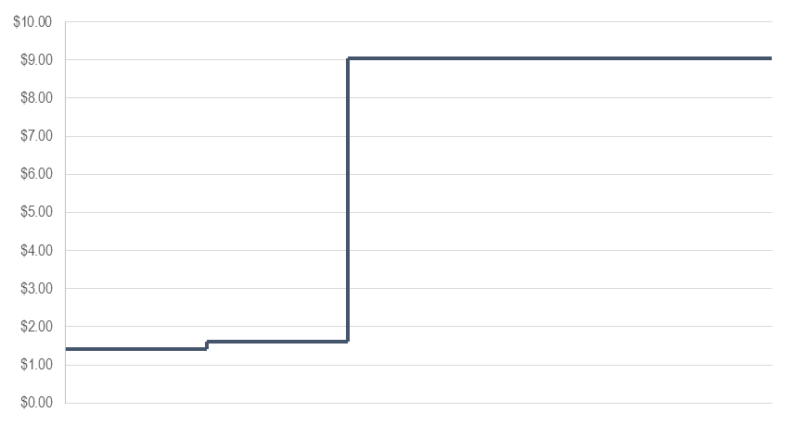
Integrated Drought Actions
20%
Alternate plan approval by SWRCB
  1 of 2 in California
Water Budget Based Rates
Water Shortage Contingency Plan
Customer communications
Recycled Water Master Plan
Partnership with cities
Media
Water Shortage Contingency Plan Stage 2
Penalty
Tier 1
Tier 2
Tier 3
Tier 4
Tier 5

Slide 21




Customer Communications
Bill Messages
Summer Newsletter
Postcards
Press Release
Newspaper Ads

Slide 22
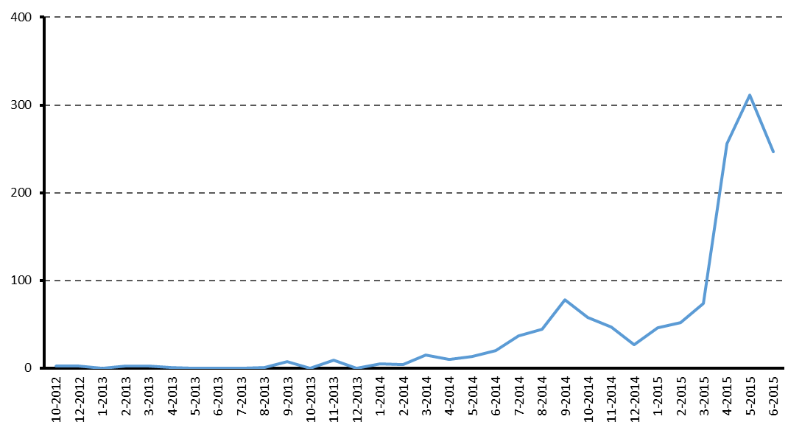
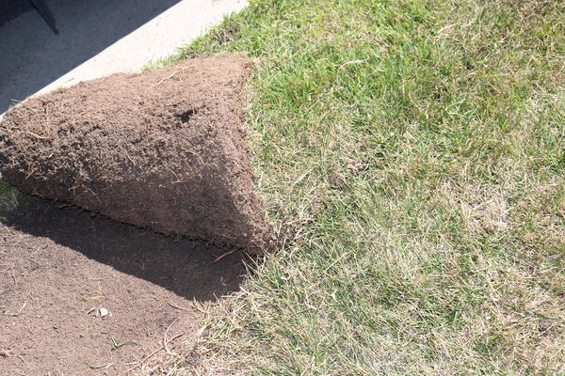
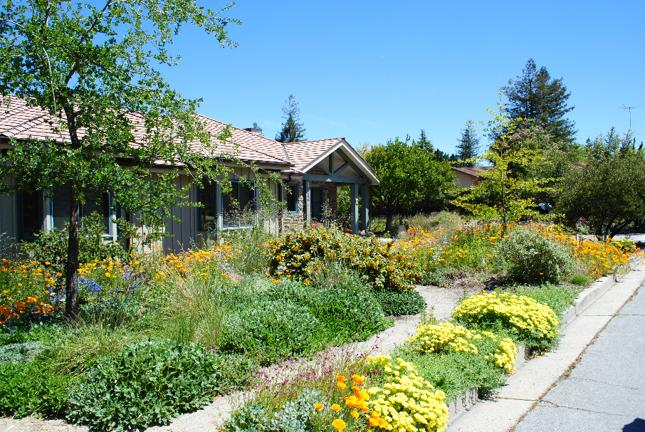
Outdoor Focus
50 to 70% for outdoor usage
Approximately 300 million square feet of irrigable area in service area
Approximately 3 million square feet of turf removed
# of Turf Applications

Slide 23

Results
Exceeded targets for June, July, August, and September
Highest ever percentage of customers within their water budget
Financially stable after greater than 20% reduction in demand
Lowest overall water use since 1990
Currently at approximately 50% of per capita water use in 1991
SWRCB
  Rate Structure - Best Practices/Examples for
  Conservation Water Pricing
CA Department of Water Resources
  Urban Water Management Plan Case Study
Sept: 26%
August: 22%
July: 27%
June: 22%
May: 29%

Slide 24
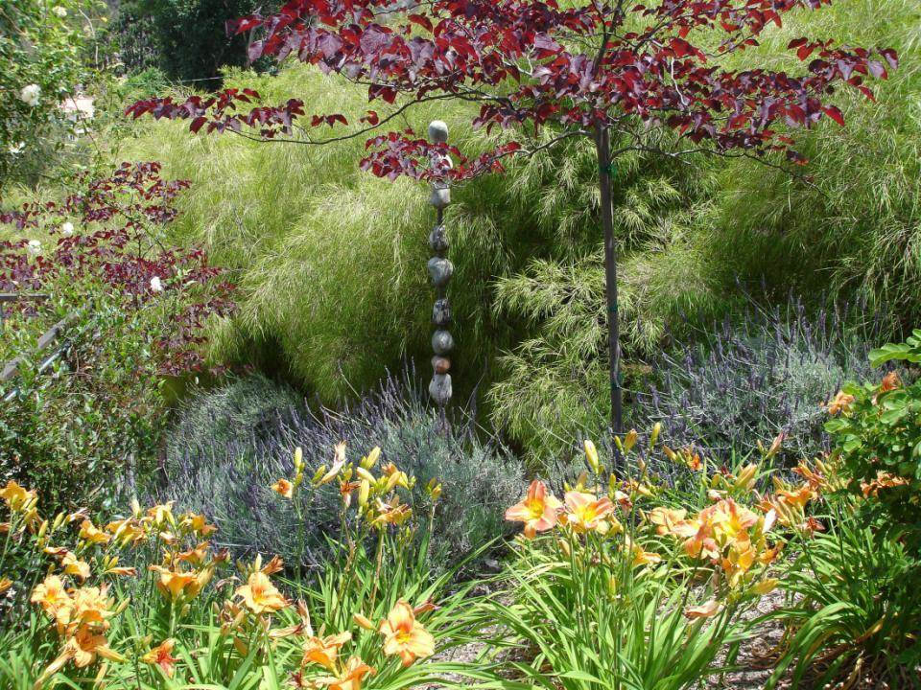


What’s Next?
Research with academic
Institutions to inform innovation
  Stanford- Marketing
  UC Riverside- Rates & Rebates

Slide 25





The next frontier
  California water data collaborative: putting the entire lifecycle of California's water usage data in a centralized cloud database on a voluntary, bottom up basis.

